Slide 1
Cruise Ship Industry Potential Impact on Air Quality
DEPARTMENT OF ENVIRONMENTAL CONSERVATION DIVISION OF AIR QUALITY and DIVISION OF WATER QUALITY
SEPTEMBER 12, 2018
1
Notes:
Presentation for Juneau Commission on Sustainability. Given on 9/12/2018, at 5:30pm at the Downtown Juneau Public Library.

Slide 2
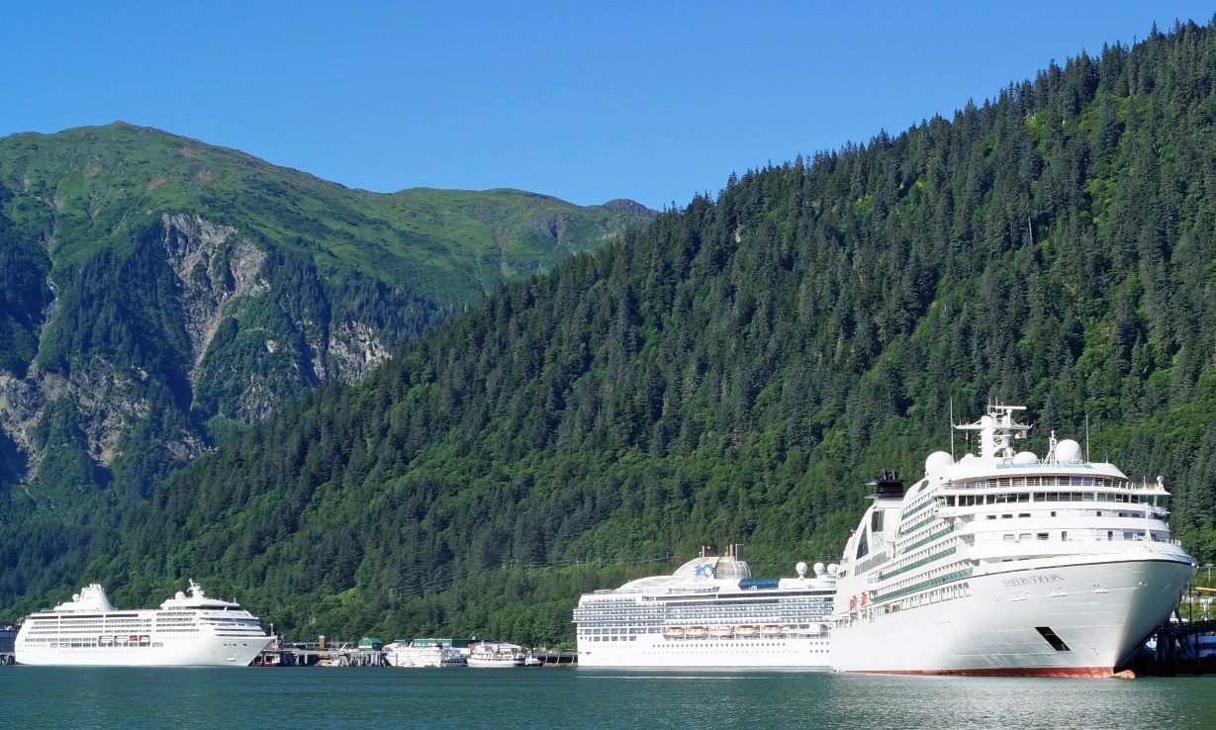
Who at DEC Regulates Cruise Ships?
Wastewater
Cruise Ships
Opacity
Air
Ambient Air Quality
Yellow – Division of Water Quality; Cruise Ships – Ed White
Green – Division of Air Quality; Denise Koch

Slide 3
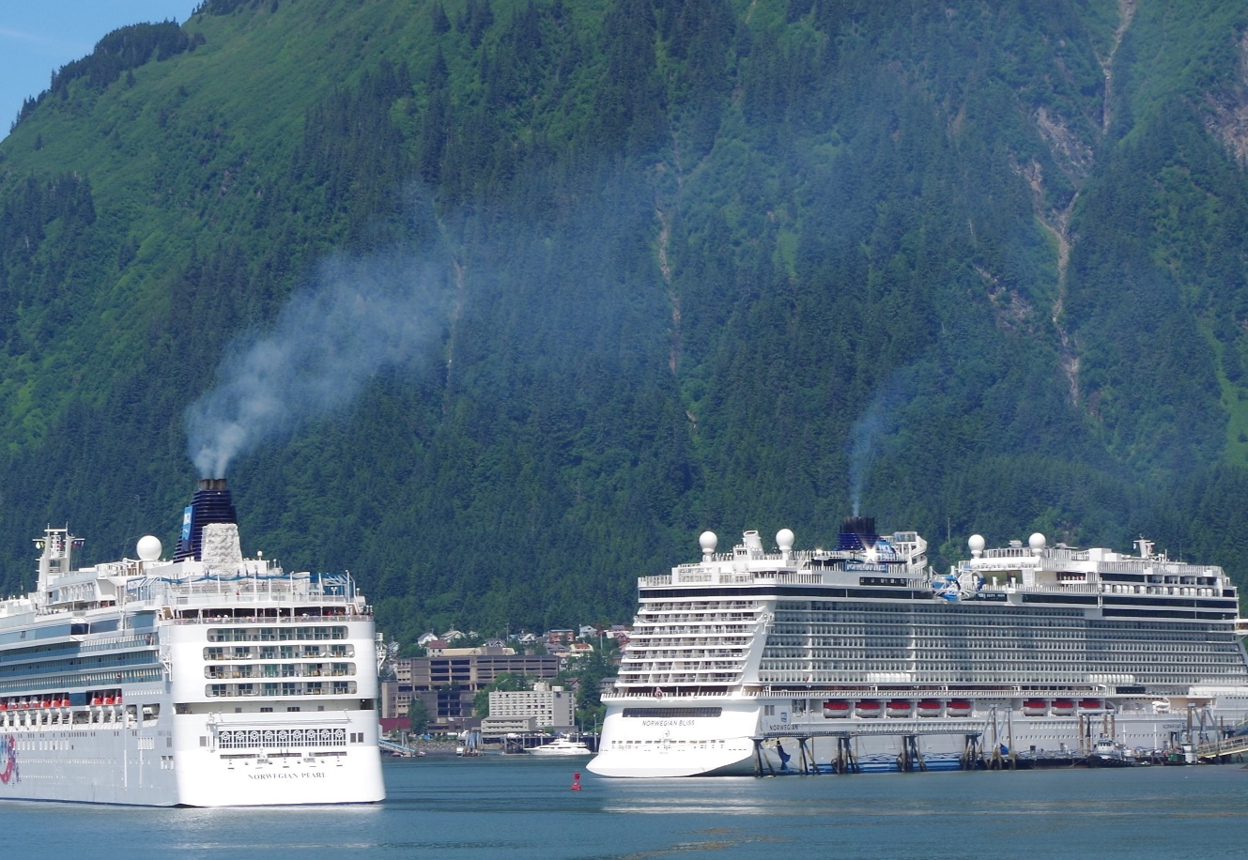
Emissions
Exhaust Gas Cleaning (Scrubbers)
  Emission Control Area (Annex VI) ECA
  Starting in 2015 vessels must use fuel containing less than 0.1% sulfur or an approved equivalent method
  Scrubbers authorized by EPA
  Inspected and certified by Coast Guard
  Annex VI does not cover all of Alaska – covers east of Kodiak Island.

Slide 4
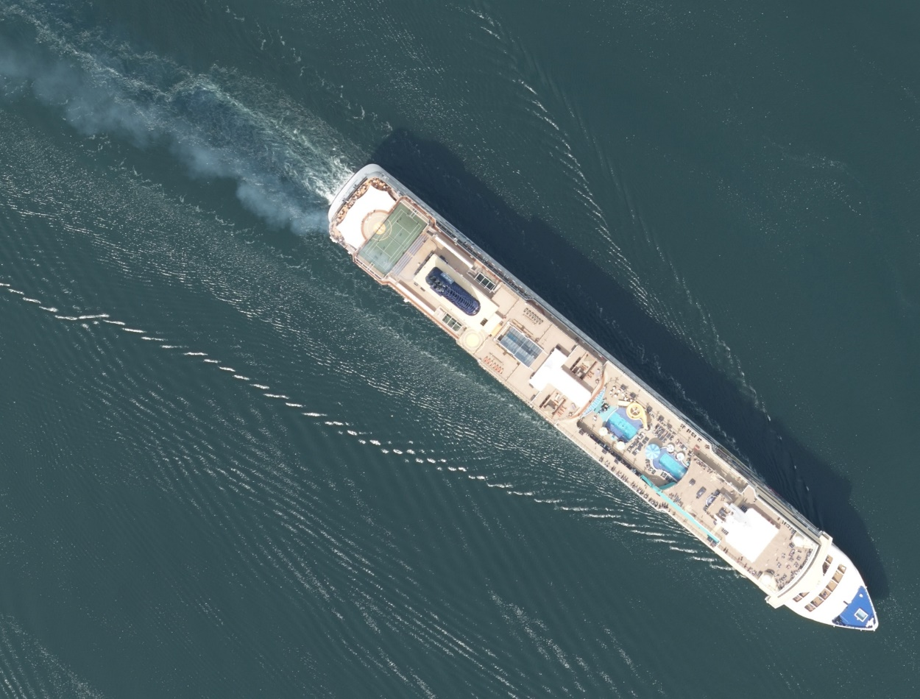
Opacity
All ships must comply with State’s Opacity limits 18 AAC 50.070
  State of Alaska has been monitoring vessel air emissions since 1970s, use EPA Method 9
  Opacity limits are 20% with limited time exemptions for maneuvering and engine start up
Notes:
18 AAC 50.070. Marine vessel visible emission standards
1)(A) While vessel is at berth or anchor (over 20% for up to three minutes )
(1)(B) While vessel is at berth during initial startup of the vessel preparing to cast off or weigh anchor (over 20% for up to six minutes)
(2)During the hour immediately after weighing anchor or casting off (up to 40% for an hour or up to 100% for nine minutes)
(3) During the hour before completion of maneuvering to anchor or making fast to shore (up to 40% for an hour or up to 100% for nine minutes)
(4)Vessel underway and not covered under 1-3 above (over 20% for up to three minutes )

Slide 5
Opacity Monitoring and Compliance
Opacity Readings Per Year Summary
Year | 2014 | 2015 | 2016 | 2017 | 2018
Number of Readings | 382 | 343 | 388 | 552 | 380*
Opacity Enforcement Action Per Year Summary
Year | 2010- 2014 | 2015 | 2016 | 2017 | 2018
Violations | 49 | 0 | 0 | 2 | 9*
Settlement totals | $533,125 | $0 | $0 | $75,000 | TBD
*As of September 7, 2018
5
Notes:
Currently there are 2 active COBC that cover 2 operators (and their Alaska fleet).

Slide 6
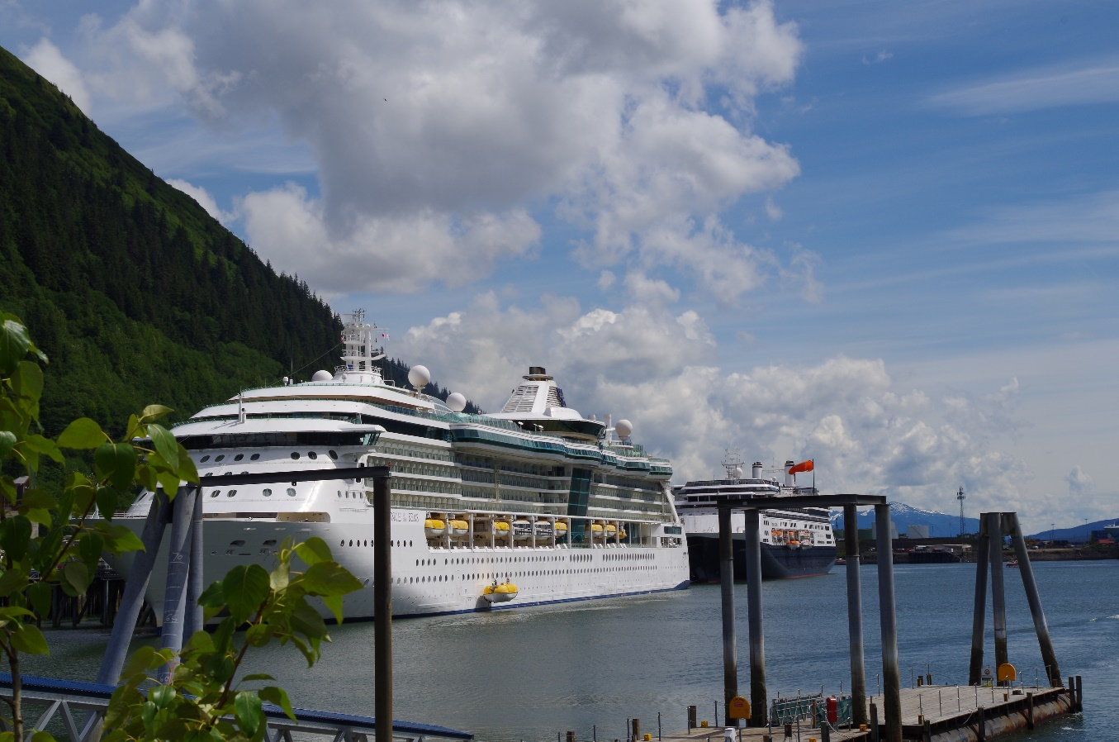
Ambient Air Quality
Federal Government established national ambient air quality standards (NAAQS) for the protection of public health.
In 2000 an Ambient Air Quality study was conducted in Juneau due to concern about cruise ship opacity.
  No exceedances of air quality standards were found in the 2000 study

Slide 7
2019 Ambient Air Quality Study
ADEC Air Quality is planning an ambient air study for calendar year 2019.
Purpose of 2019 Juneau Ambient Air Quality Study: Assess the impact of marine vessel opacity and bus traffic has on Juneau’s Ambient Air Quality
  Screening Level Study/Saturation Study
  Large number of non-regulatory quality monitors to be set up in a grid like manner
    Will select technologies to measure fine particulate matter (PM2.5) and SO₂
    Site selections yet to be made
    Monitoring both during and outside of cruise ship season
    Results of screening level study and available funding will determine future actions.

Slide 8
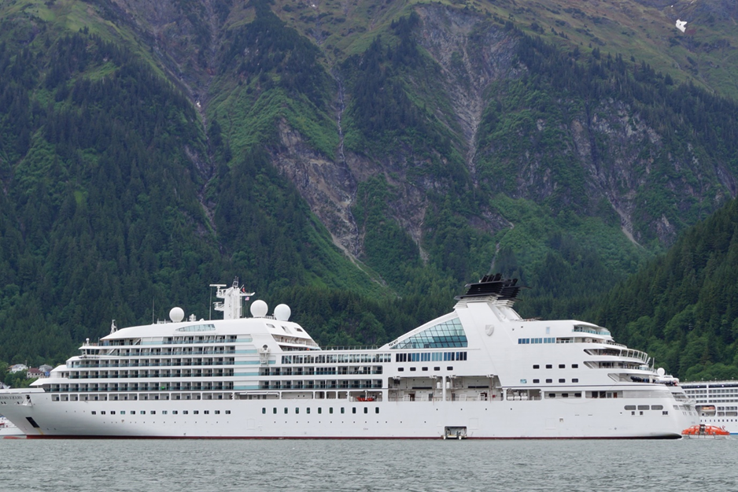
Public Input and Outreach
Public meeting on cruise ship wastewater and air quality tentatively scheduled for Fall of 2018.
Screening Level Study/Saturation Study
  Site selections and permission needed if monitors are on private property
  Private citizen agreements
  ADEC will try to address areas of high concern

Slide 9
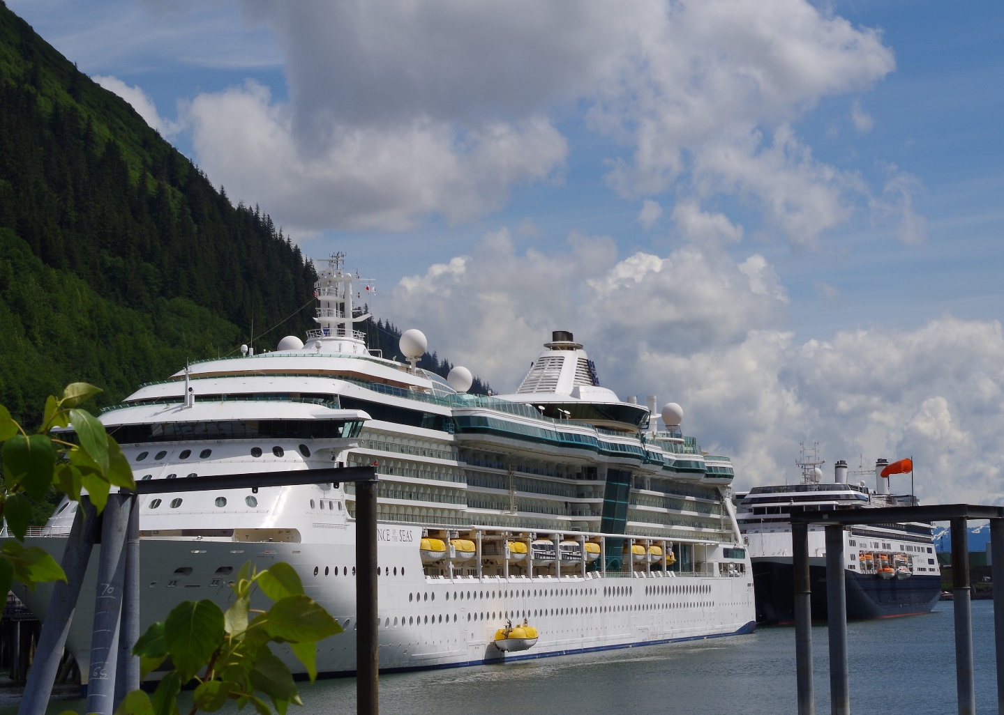
Contact Information
Edward White 907.465.5138 edward.white@alaska.gov
Denise Koch 907.465.5109 denise.koch@alaska.gov
Cruise Ship website http://dec.alaska.gov/water/cruise-ships/

