Slide 1


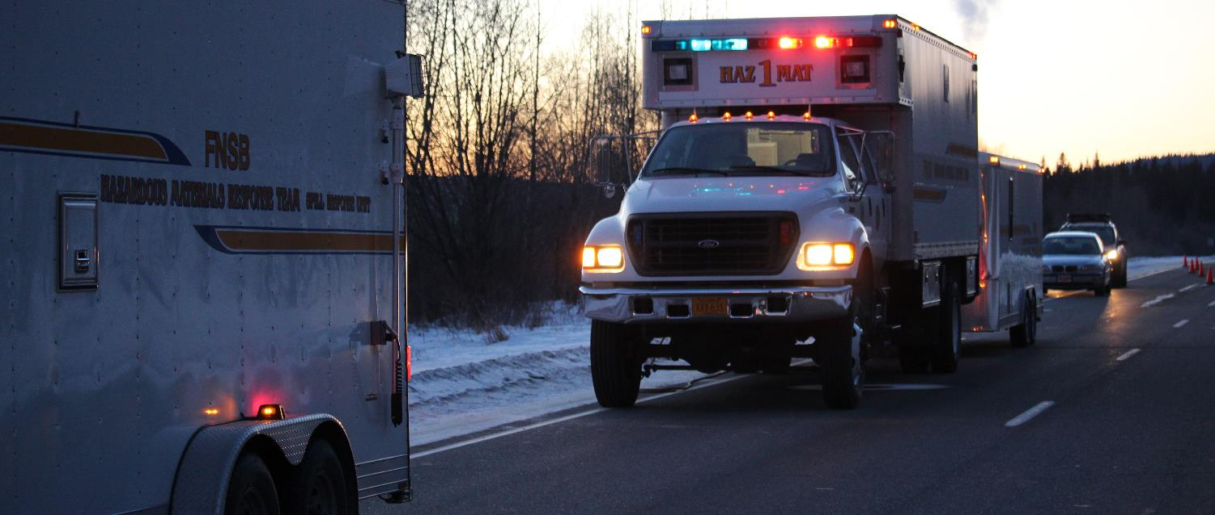
Chemical Accident Response Considerations “What do you do when it all goes bad?”
FNSB HMRT

Slide 2
Tyler Bones
Chief of the Fairbanks North Star Borough HazMat Response Team
25-years+ experience emergency response, to include spill, fire, rescue, medical, hazardous materials
HSSE Manager for AWE
Emergency Response Team Member AWE
Adjunct Instructor University of Alaska Fairbanks

Slide 3
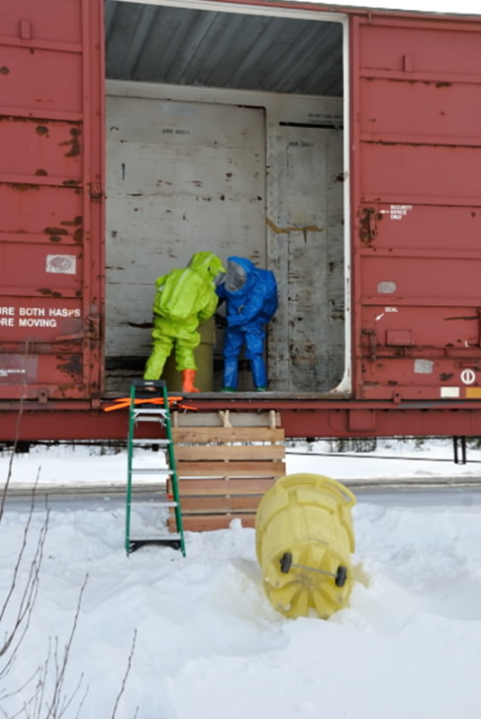

FNSB HMRT Background
1980’s Railcar incident in Fairbanks prompted the formation of the LEPC and HMRT
1996 HazMat Response Planning Concept
Alaska Department of Environmental Conservation
Anchorage Fire Department
Fairbanks North Star Borough

Slide 4
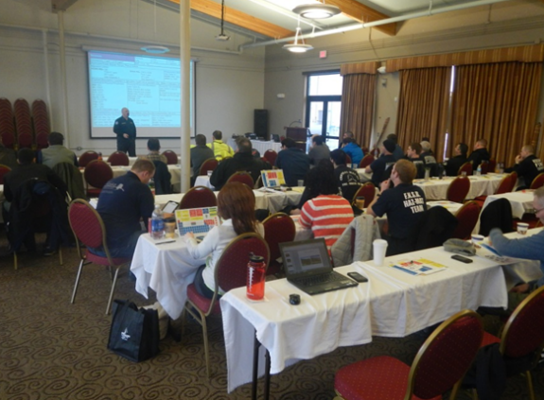
FNSB HMRT Background
1997 Fairbank North Star Borough became the first Statewide HazMat response team
Anchorage FD signed up 6 months later

Slide 5


FNSB HMRT Background
Current Statewide Teams:
FNSB
Anchorage
Kodiak
Juneau / Ketchikan

Slide 6
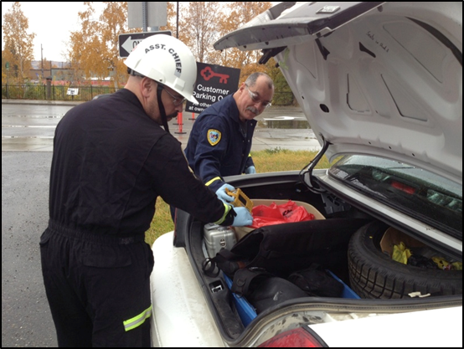
FNSB HMRT Background
All volunteer Team (29 members)
Made up of personnel from all walks of life
Housed in four locations around the Borough
Funded through grants

Slide 7
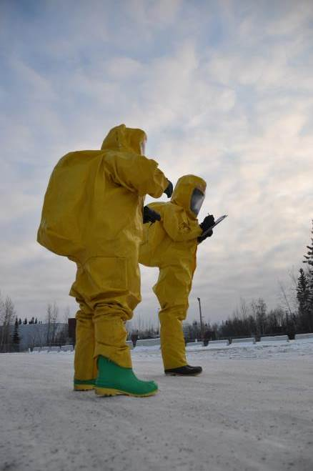
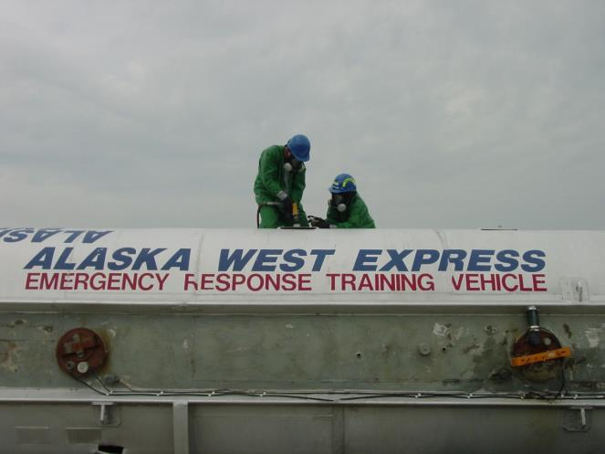

FNSB HMRT Capabilities
All levels of HazMat response capable

Slide 8
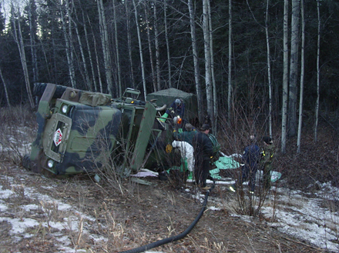
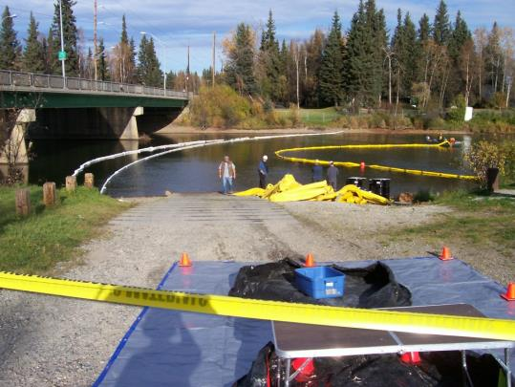
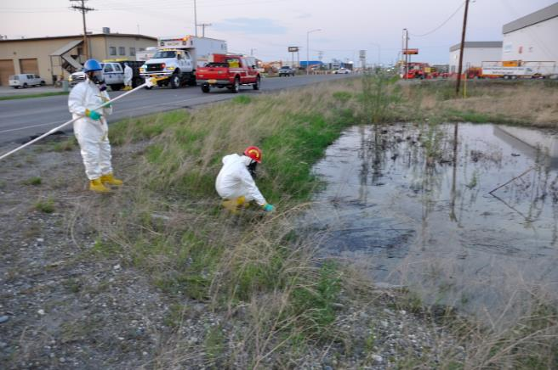
FNSB HMRT Capabilities
Spill Response

Slide 9
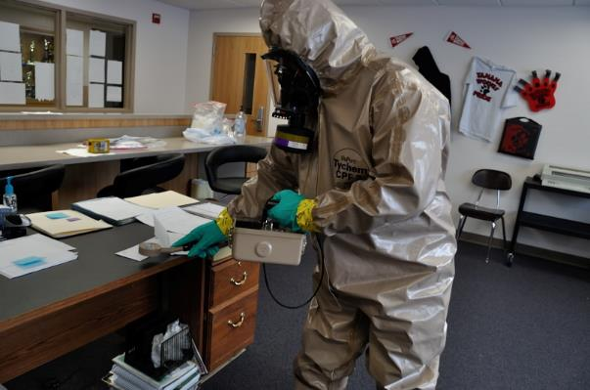
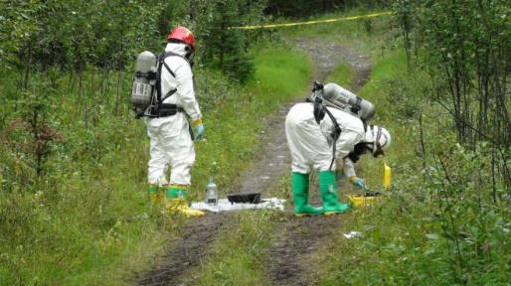
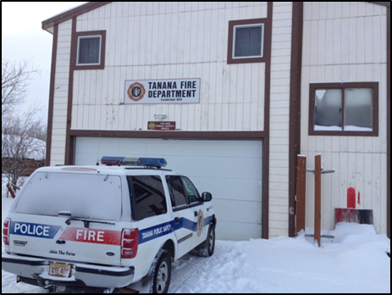
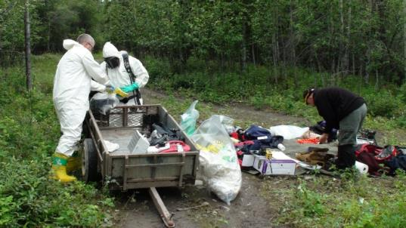
FNSB HMRT Capabilities
Statewide Deployable

Slide 10
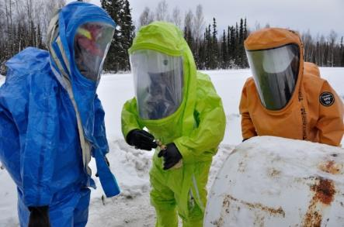
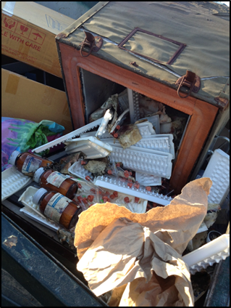
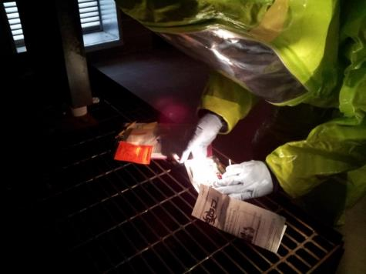
FNSB HMRT Capabilities
Chemical, Biological, Radiological, and Nuclear detection

Slide 11
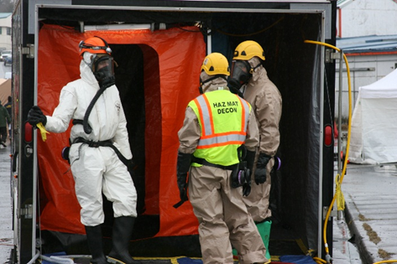
FNSB HMRT Capabilities
Decontamination resources to include Mass Decon

Slide 12
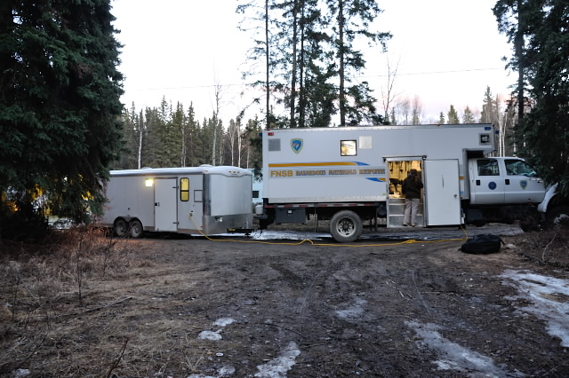
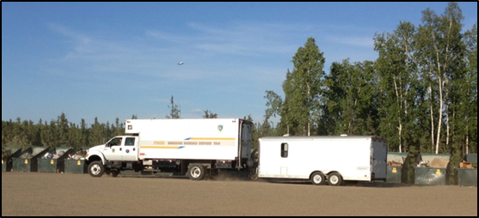
FNSB HMRT equipment

Slide 13
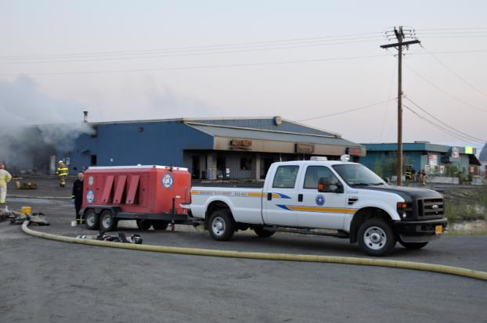
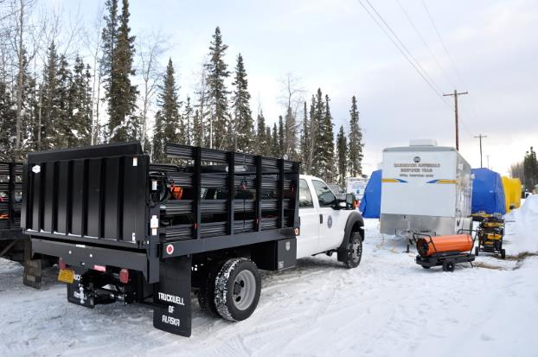
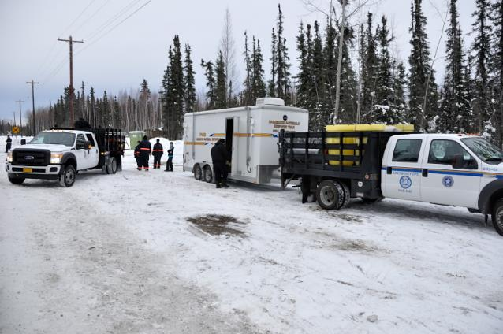
FNSB HMRT equipment

Slide 14
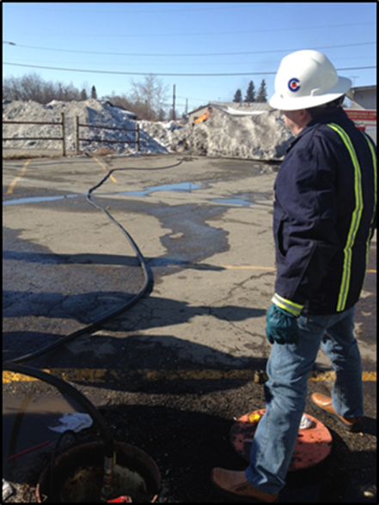
FNSB HMRT Initiatives
Local Responses
Statewide Response Agreements
Train local and Statewide responders
Community HazMat Projects

Slide 15
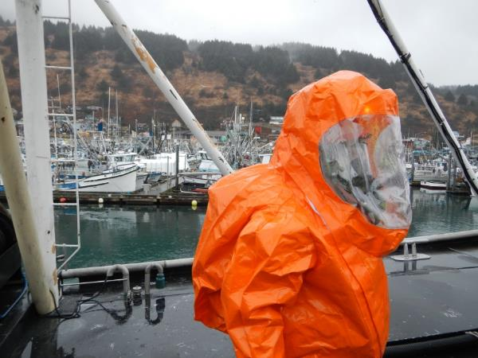
FNSB HMRT Initiatives
Personnel serve on Local, State, and National level committees
Borough Emergency Services Commission
State of Alaska HazMat Working Group
LEPC
National Training Committees

Slide 16
FNSB HMRT
If we are requested to respond to an incident, here are a few of our expectations:
We want to work with you, the RP, preferably the Incident Commander.
We will assist with the response, but we will not take over the response.
We do not do clean up activities.
All waste generated (PPE, containers, etc.) is the responsibility of the RP to dispose of properly.

Slide 17
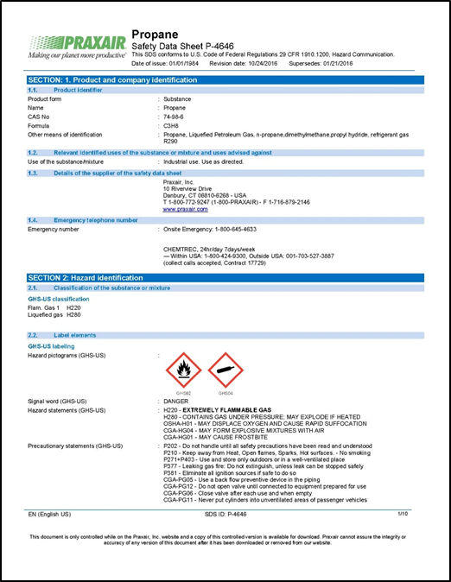
So how do you prepare

Slide 18


Where do you start?
Start before the load is dispatched…
Identify the hazards before transporting
DOT Hazard Class is a good starting point, but there are limitations
SDS are one of the best tool we can have

Slide 19
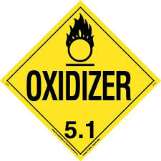
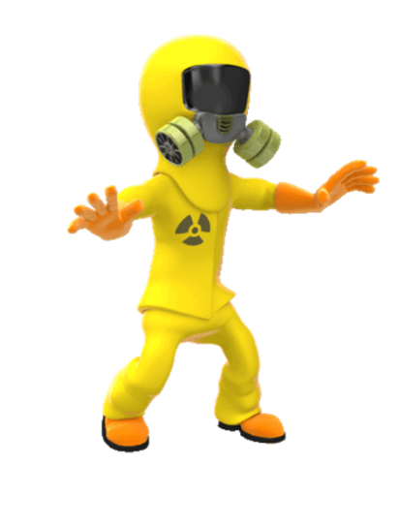
Ask questions?
Are your personnel trained on the product(s)?
Is your transport equipment suitable for the product(s)?
Are your response kits capable?
If you have a response contractor, are they prepared?

Slide 20
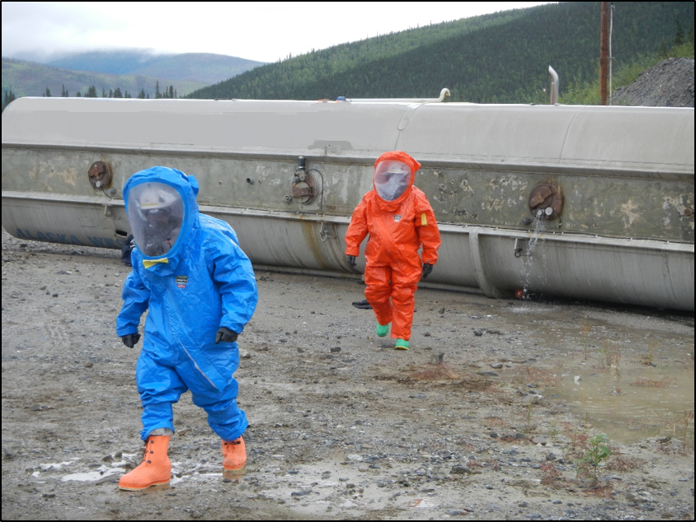
What do you do if the unthinkable happens

Slide 21
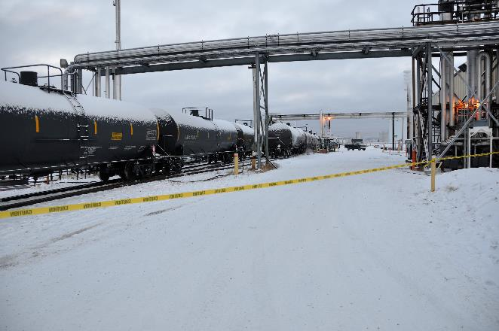
Initial Response Steps
SAFETY –
Approach cautiously Up Wind, Up Hill, Up Stream
Isolate the area and Deny Entry –
Establish initial isolation distances

Slide 22
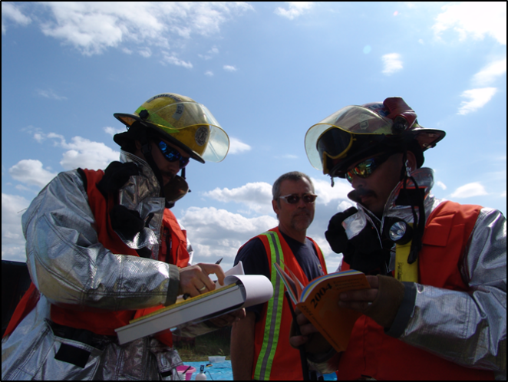
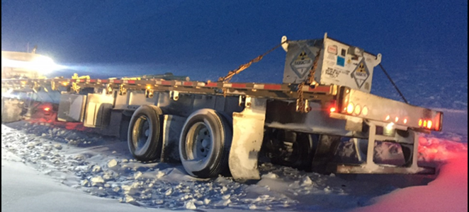
Initial Response Steps
Identify the Hazards:
Materials involved
Condition of the containers
Review ERG and SDS

Slide 23
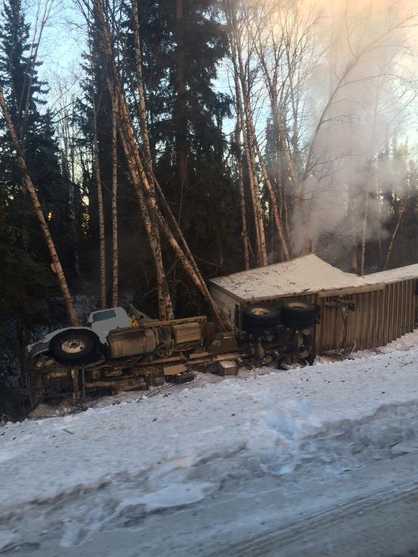
Initial Response Steps
Assess the Situation:
Is there a fire, a spill, or a leak?
What are the weather conditions?
What is the terrain like?
What is the spilled material doing?

Slide 24
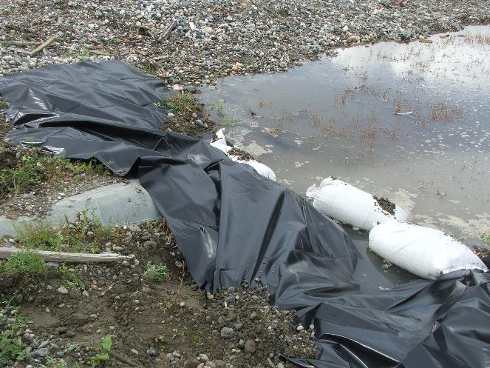
Initial Response Steps
Assess the Situation:
Who/What is at risk?
What actions should be taken?
What resources are required?
What can be done immediately?

Slide 25
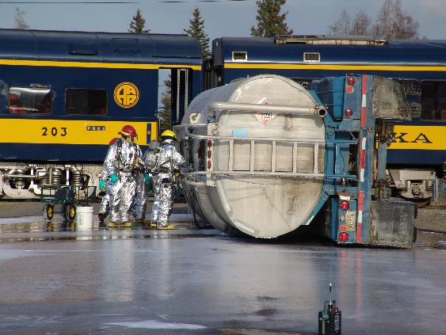
Initial Response Steps
Obtain Help!
Get help coming!
Respond / Containment Actions
Only respond if you have the proper PPE
Establish Command
Continually reassess the situation and modify your response accordingly
Consider the safety of people in the immediate area, including you!
Be able to perform decontamination on-scene

Slide 26
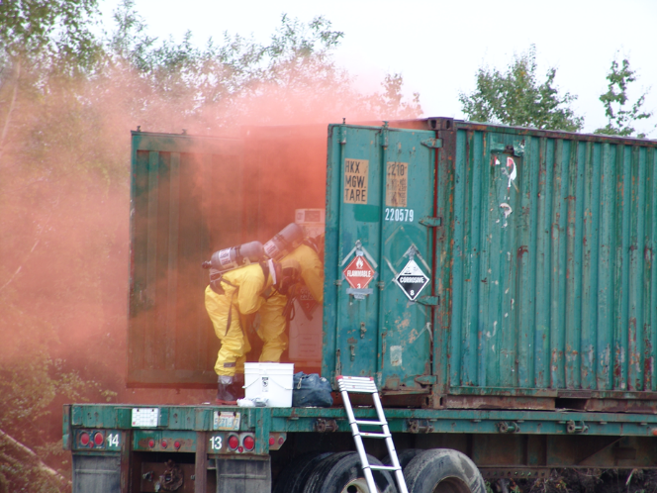
IDLH SITUATIONS
STAY OUT OF VAPORS, FUMES, SMOKE, AND SPILLS!
DO NOT assume that gases and vapors are harmless because of a lack of odor!

Slide 27

Initial Response Steps
Use your ERG
All of the steps are listed on Page 4 of the ERG.
The ERG is the best practice for initial response to a HazMat incident

Slide 28
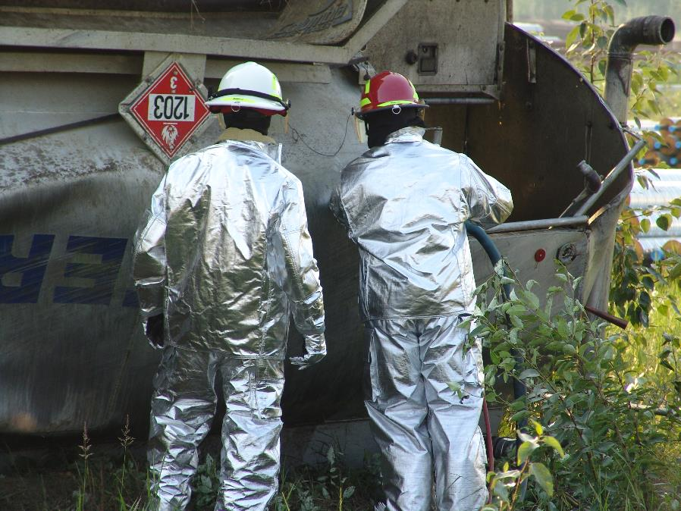
Lessons learned

Slide 29
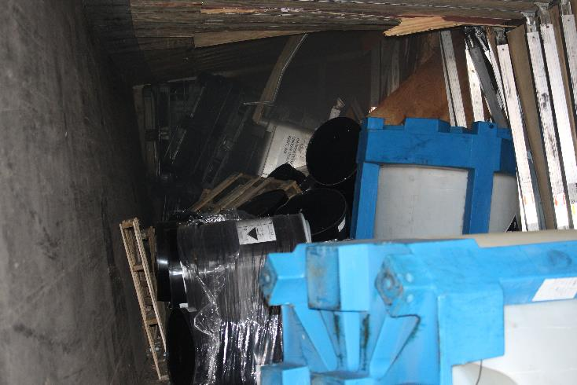
Lessons Learned
No matter how nice it was loaded, it is still going to be a mess post accident
Be prepared to move drums, totes, etc.
Stabilization of equipment, sharp edges, access, etc. needs to be considered

Slide 30
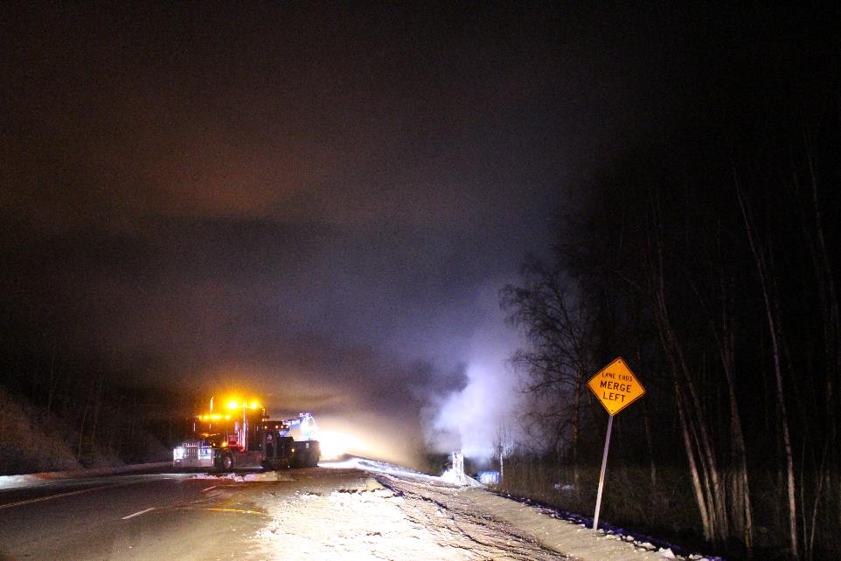
Lessons Learned
Just because it looks like smoke does not mean that it is.

Slide 31
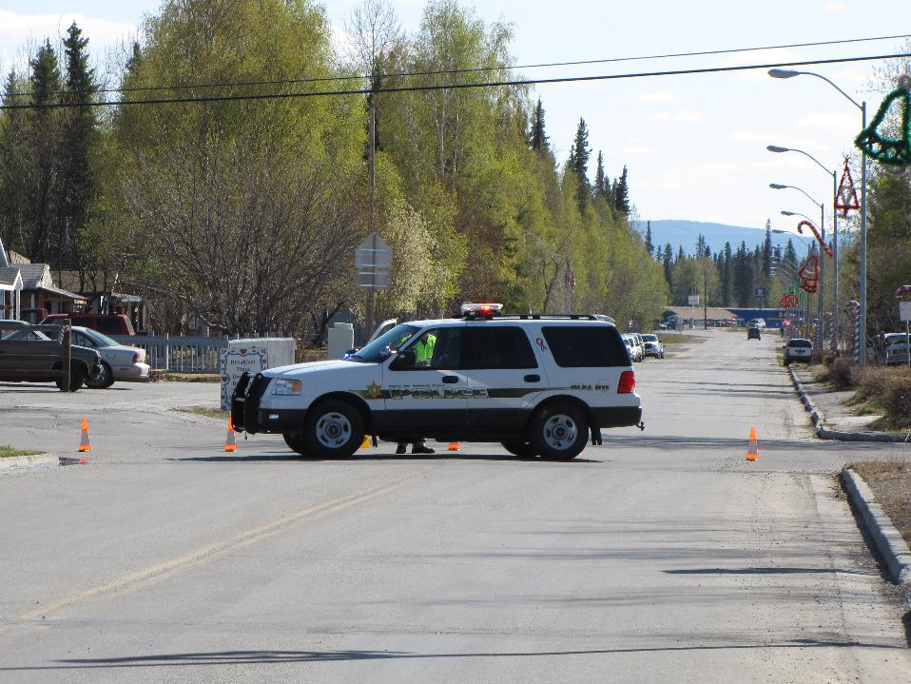
Lessons Learned
Traffic control should be considered immediately.

Slide 32
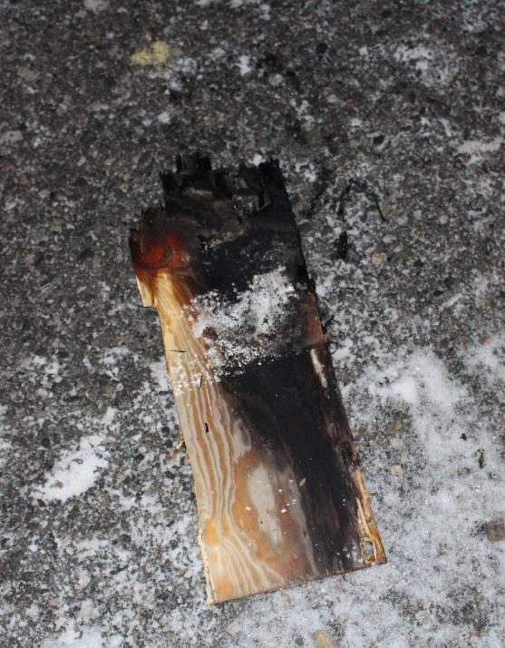
Lessons Learned
Chemical reactions have to be considered and prepared for.
Pumps have to be rated for the material.
Is your PPE able to protect you?

Slide 33
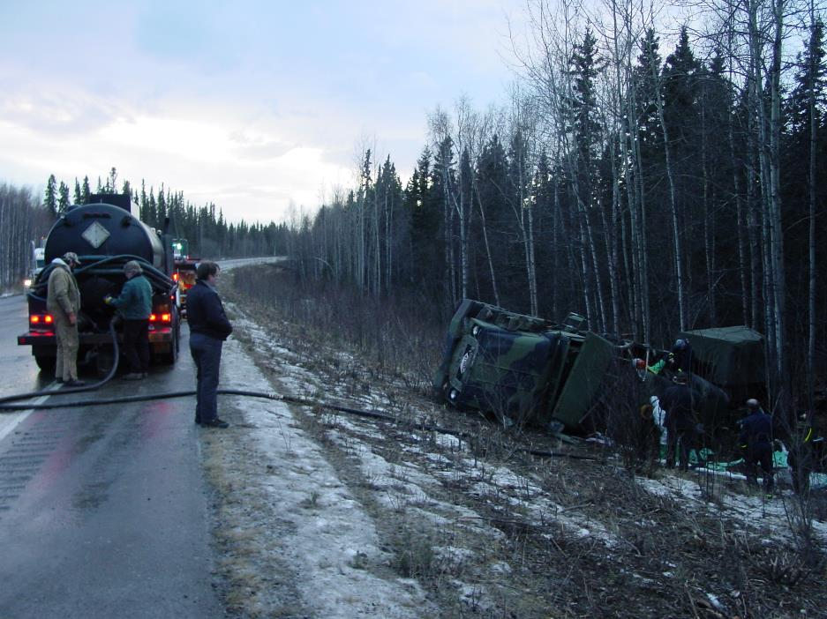
Lessons Learned
Your Spill Response contractor has to be prepared to respond.

Slide 34
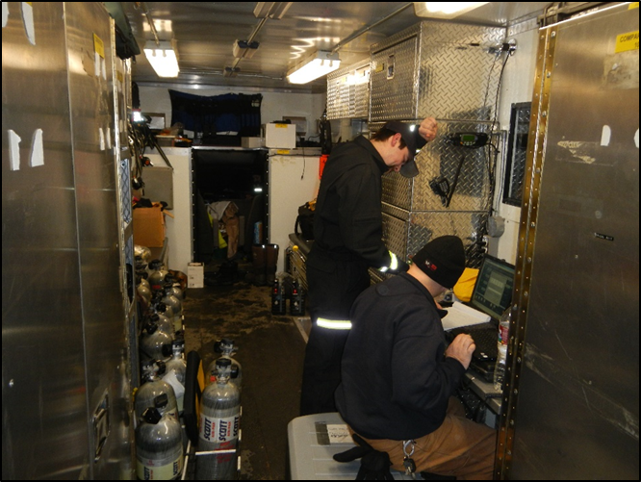
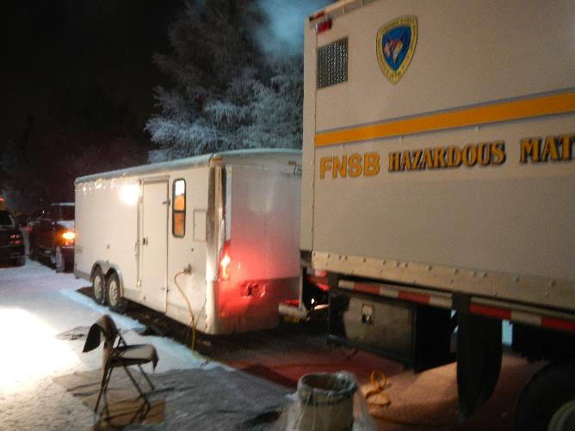
Lessons Learned
Long Duration incidents:
Food, coffee, water, bathrooms, sleep

Slide 35
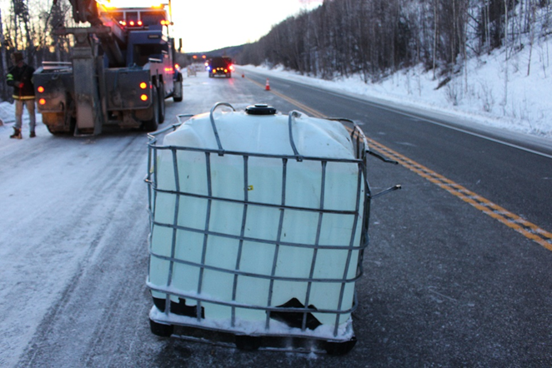
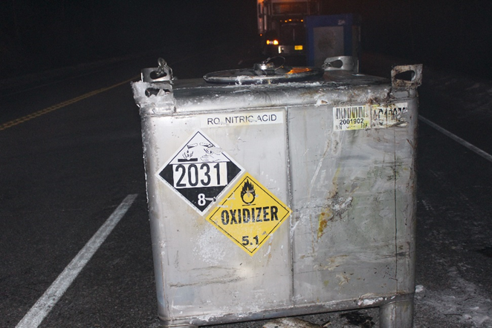
Lessons Learned
When responding, you have to understand the containers that you are dealing with.
Proper handling
Types
Volumes
How to transfer out of

Slide 36
Conclusion
You have to understand the chemicals you are transporting.
Be prepared to respond
Practice before an incident happens
Important to follow State and National regulations and guides
Don’t be afraid to customize the tools to fit your needs
You must train your employees before you can expect them to respond
Foster relationships before an incident occurs

Slide 37
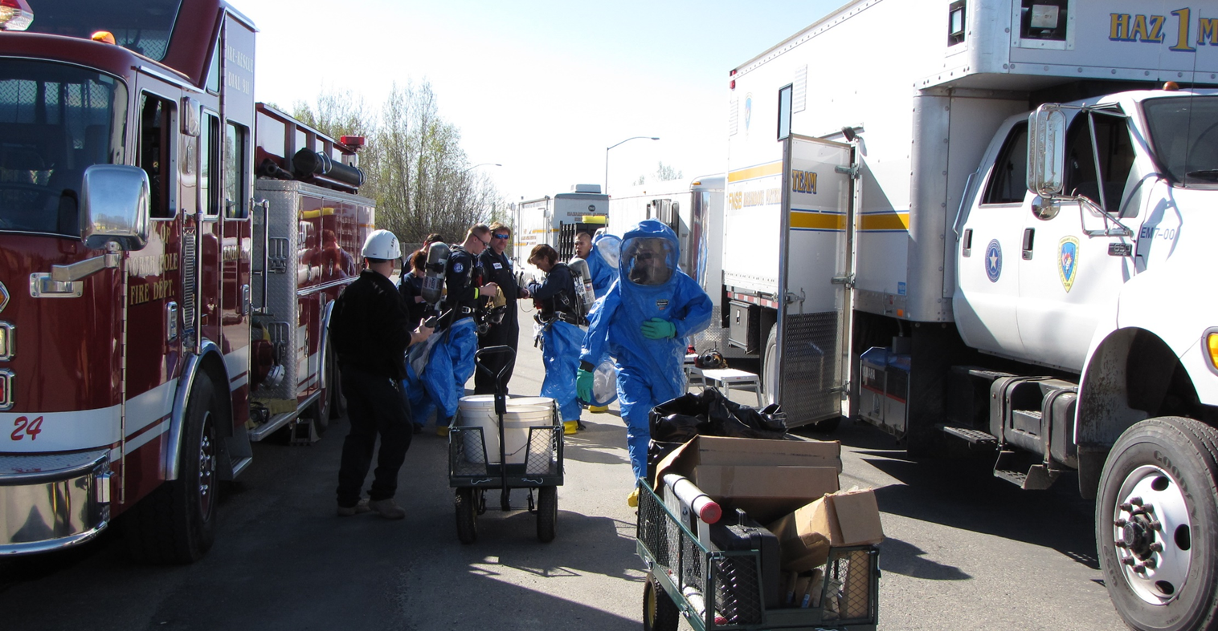
Questions?
Tyler Bones
Fairbanks North Star Borough
HazMat Response Team
(907) 328-4332
tbones@lynden.com

