Slide 1
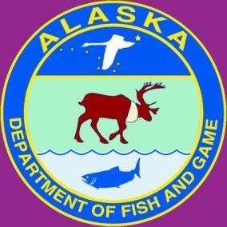
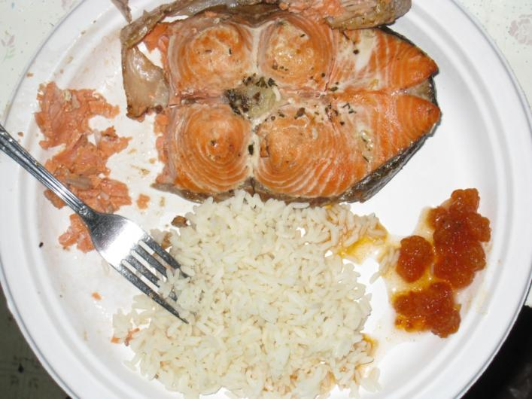
Wild Food Consumption Rate Estimates: A Regional Analysis Approach
James A. Fall
Marylynne L. Kostick
Division of Subsistence, ADF&G
Human Health Criteria
Technical Workgroup Meeting
October 12, 2016
Meal of salmon, salmonberries, and rice, Sleetmute, Alaska

Slide 2
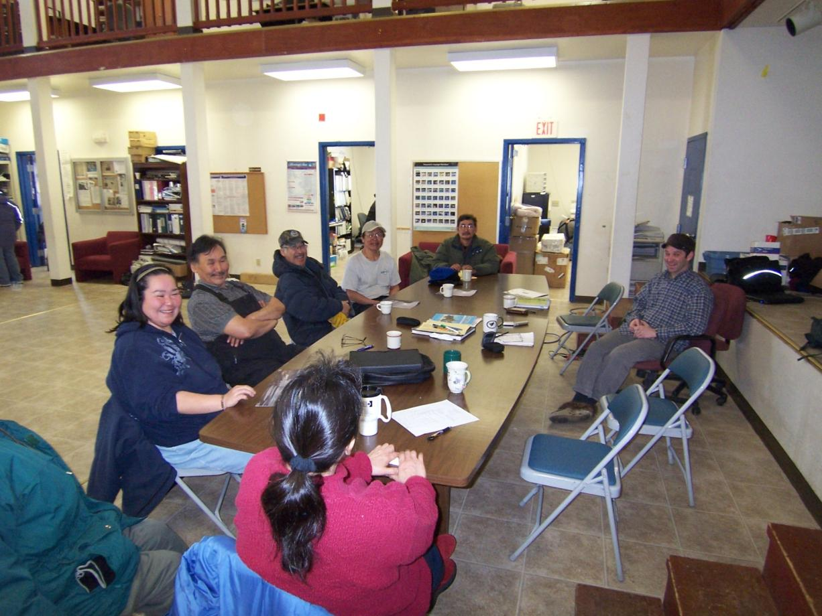
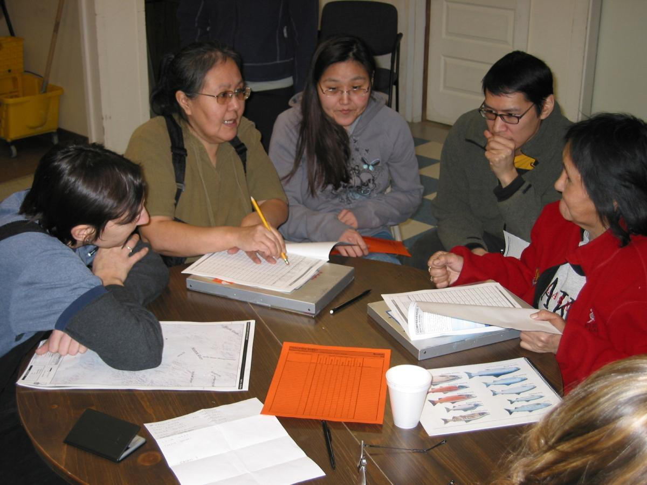
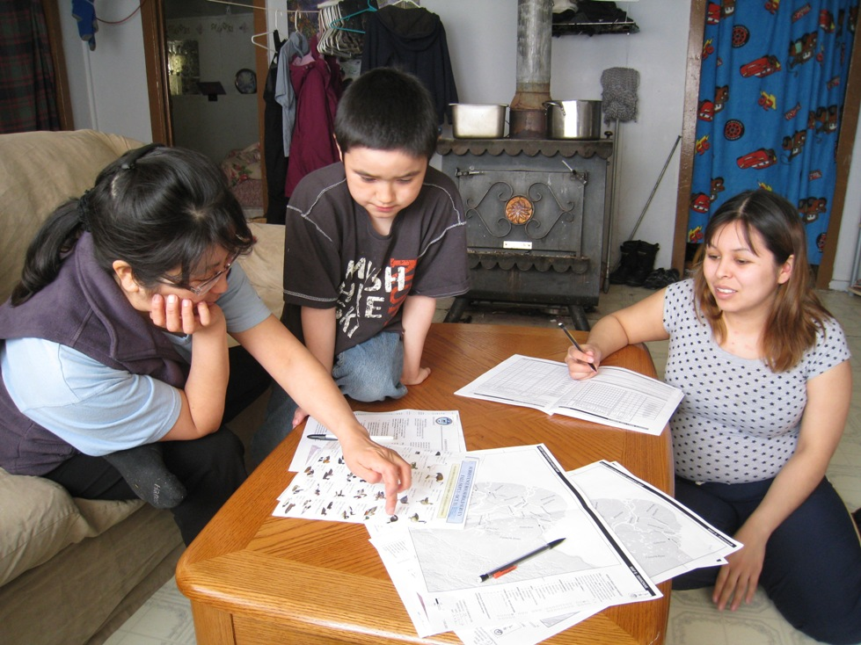
Alaska Statute 16.05.094 lists “duties”
Research and data compilation
Data reporting and education
Application of study findings
(Introducing a project in Togiak)
(Local research assistant orientation in Noatak)
(Survey administration in Emmonak)

Slide 3
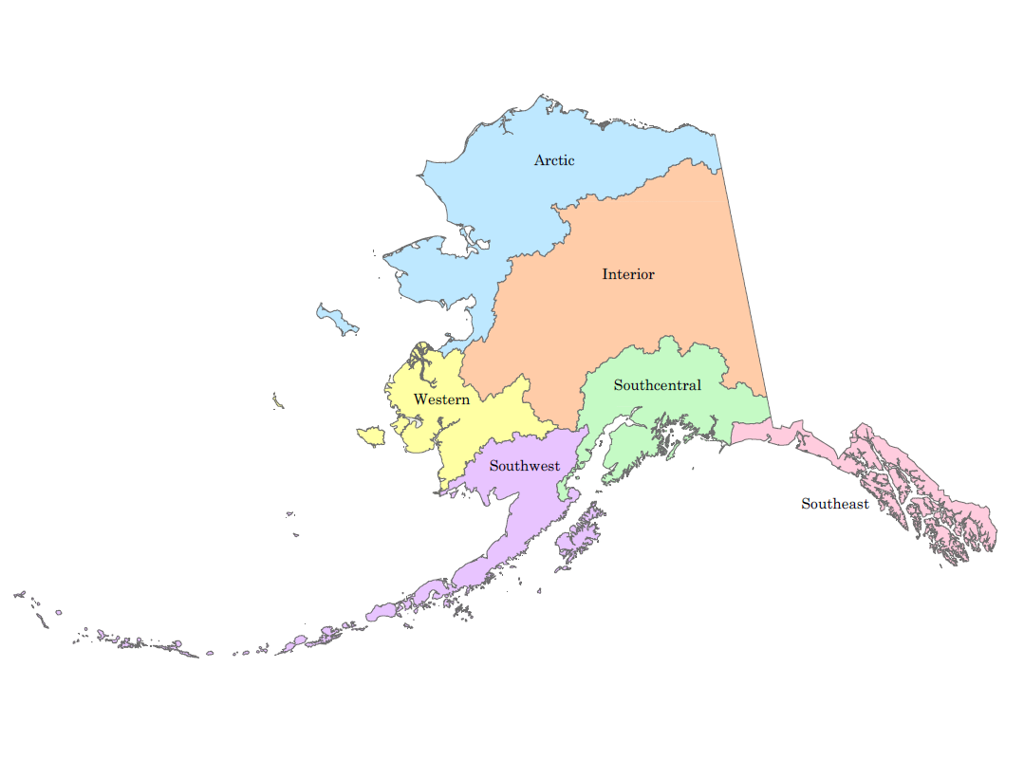
Regional and Rural Estimates
Study years included in present analysis: 2012-2014
A total of 78 communities, representing all six regions of Alaska
  Southeast (n=6)
  Southcentral (n=20),
  Southwest (n=16)
  Western (n=6)
  Arctic (n=21)
  Interior (n=9)

Slide 4
Regional and Rural Estimates
Resources: Salmon, non-salmon/freshwater fish, marine invertebrates, marine mammals
Groups: All user groups (including non-users) v. Users only
Mean, Median, 75th, 85th, 90th and 95th Percentiles
Percentile user groups:
  User group 1: Harvest, did not share
    Use Level = (Total household harvest) / (Total household size)
  User group 2: Sharing network
    Use Level = (Sum total of harvests from households that harvested and shared) / (Sum total of household members of households that harvested/shared or did not harvest/received)
  User group 3: Did not use
    Use = 0

Slide 5
Mean & 95th Percentile Comparisons
Non-salmon freshwater fish, marine invertebrates
All user groups
Users only

Slide 6
Mean & 95th Percentile Comparisons
Salmon, non-salmon freshwater fish, marine invertebrates
All user groups
Users only

Slide 7
Mean & 95th Percentile Comparisons
Salmon, non-salmon freshwater fish, marine invertebrates, marine mammals
All user groups
Users only

Slide 8
Mean & 95th Percentile Comparisons
Salmon only, Users only
Salmon per capita consumption comparisons, Alaska.
Area |  | Fish Consumption Estimates Per Capita (grams per day)
 |  | All user groups
 |  | Mean | Median | Percentiles
 |  |  |  | 75th | 85th | 90th | 95th
Statewide
Urban |  | 4.8* |  | - | - | - | -
Rural/Subsistence |  | 83.8 | 62.4 | 109.0 | 127.7 | 141.7 | 274.1
 | Southeast | 110.9 | 63.9 | 104.9 | 267.0 | 267.0 | 347.8
 | Southcentral | 103.0 | 79.6 | 141.7 | 153.8 | 178.3 | 228.5
 | Southwest | 260.4 | 207.9 | 273.4 | 396.3 | 609.3 | 946.3
 | Western | 97.5 | 85.3 | 108.9 | 124.7 | 145.2 | 159.0
 | Arctic | 53.0 | 32.2 | 62.3 | 110.2 | 115.7 | 120.0
 | Interior | 108.9 | 54.8 | 183.5 | 307.2 | 326.5 | 326.5

Slide 9
Urban and Rural Comparisons
Mean per capita wild food consumption rate estimates for all user groups by resource category and area in grams per day, Alaska.
Area | Salmon | Non-salmon fish, marine invertebrates | All fish, marine invertebrates
Urban (2014) | 4.8 | 4.0 | 8.9
Rural | 83.8 | 69.5 | 149.1
Southeast | 110.9 | 53.4 | 159.5
Southcentral | 103.0 | 18.2 | 123.2
Southwest | 260.4 | 11.7 | 294.1
Western | 97.5 | 48.8 | 139.7
Arctic | 53.0 | 103.1 | 155.0
Interior | 108.9 | 71.5 | 180.0

Slide 10
Other Tribal, Special Interest Populations – Fish Consumption Studies
Comparisons of Pacific Northwest consumption studies with rural Alaska and US populations.
Consumption Study/Study Popluation | Median | 90th Percentile | 95th Percentile
Columbia River Tribes | 40 | 113 | 176
Tulalip Tirbe | 45 | 186 | 244
Squaxin Island Tribe | 43 | 193 | 247
Rural Alaska Population | 121 | 244 | 293
Suqaumish Tribe | 132 | 489 | NA
Asians and Pacific Islanders | 78 | 236 | 306
US Population - Consumers only | 99 | 248 | 334
Source for non-Alaska studies: http://www.deq.state.or.us/wq/standards/docs/toxics/HHFGSummaryforEQC.pdf

Slide 11
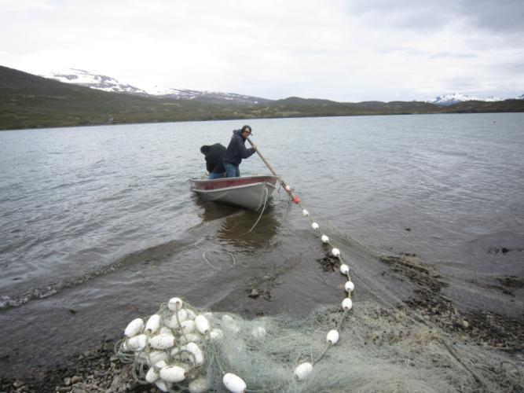
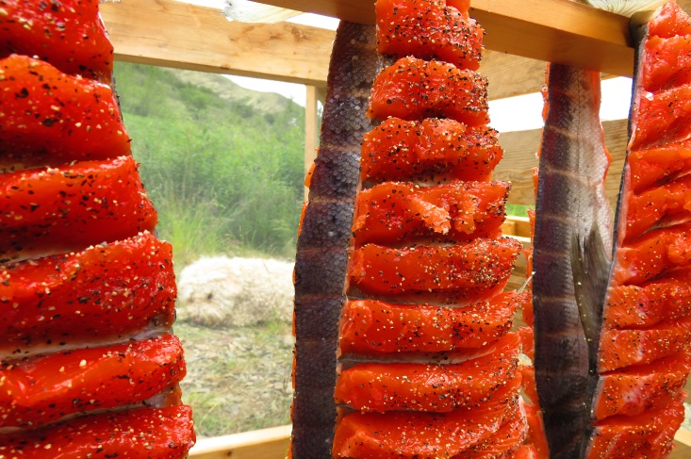
Ongoing Work by ADF&G
Preparing study communities from early 2000s through 2015 for inclusion in analysis (will add up to over 150 communities across the state)
Handling outlier consumers
Methods for weighting data
Methods for modeling communities not surveyed by ADF&G
Computing statewide statistics utilizing ADF&G Subsistence and Sport Fish data
Seldovia Tribe, ADF&G comparison
Final report will be delivered to DEC early 2017

Slide 12

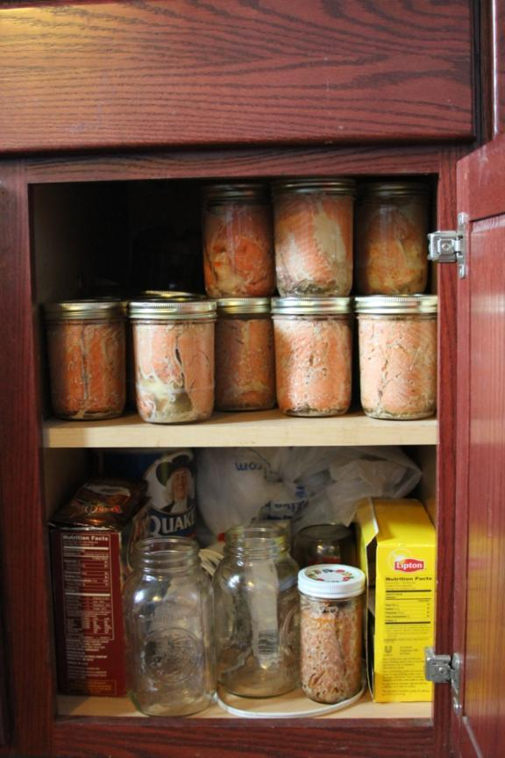
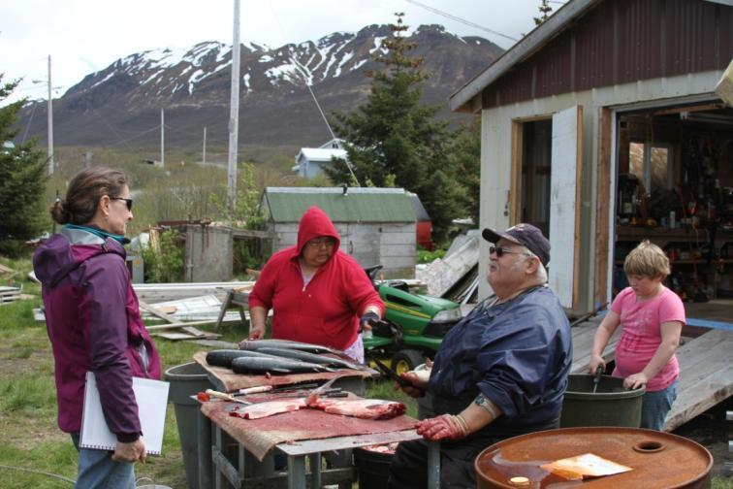
Thank you.
jim.fall@alaska.gov, marylynne.kostick@alaska.gov

Slide 13
Non-salmon freshwater fish, marine invertebrates
Sum total non-salmon fish and marine invertebrate per capita consumption comparisons, Alaska.
Area |  | Fish Consumption Estimates Per Capita (grams per day)
 |  | All user groups |  |  |  |  |  |  | Users only
 |  | Mean | Median | Percentiles |  |  |  |  | Mean | Median | Percentiles
 |  |  |  | 75th | 85th | 90th | 95th |  |  |  | 75th | 85th | 90th | 95th
Statewide
Urban |  | 8.9 |  | - | - | - | - |  | 8.9 |  | - | - | - | -
Rural/Subsistence |  | 49.3 | 27.1 | 48.0 | 63.1 | 74.9 | 153.5 |  | 69.5 | 45.1 | 227.0 | 397.8 | 635.8 | 635.8
 | Southeast | 44.0 | 32.2 | 74.9 | 82.6 | 91.9 | 118.4 |  | 53.4 | 32.9 | 118.4 | 138.2 | 138.2 | 138.2
 | Southcentral | 10.5 | 5.7 | 10.9 | 17.3 | 27.0 | 37.0 |  | 18.2 | 10.7 | 347.2 | 347.2 | 347.2 | 347.2
 | Southwest | 5.0 | 0.0 | 9.7 | 9.7 | 17.0 | 21.7 |  | 11.7 | 9.7 | 28.7 | 28.7 | 28.7 | 28.7
 | Western | 37.6 | 45.1 | 45.1 | 47.9 | 68.3 | 98.1 |  | 48.8 | 45.1 | 115.5 | 450.8 | 450.8 | 450.8
 | Arctic | 76.6 | 44.9 | 62.9 | 63.5 | 169.1 | 189.1 |  | 103.1 | 61.4 | 233.1 | 497.2 | 559.8 | 635.8
 | Interior | 44.9 | 16.3 | 57.9 | 152.9 | 171.4 | 176.4 |  | 71.5 | 56.1 | 397.8 | 397.8 | 397.8 | 397.8

Slide 14
Salmon, non-salmon freshwater fish, marine invertebrates
Sum total salmon, non-salmon fish, and marine invertebrate per capita consumption comparisons, Alaska.
Area |  | Fish Consumption Estimates Per Capita (grams per day)
 |  | All user groups |  |  |  |  |  |  | Users only
 |  | Mean | Median | Percentiles |  |  |  |  | Mean | Median | Percentiles
 |  |  |  | 75th | 85th | 90th | 95th |  |  |  | 75th | 85th | 90th | 95th
Statewide
Urban |  | 8.9 |  | - | - | - | - |  | 8.9 |  | - | - | - | -
Rural/Subsistence |  | 131.5 | 120.3 | 160.2 | 194.8 | 212.7 | 274.5 |  | 149.1 | 121.4 | 177.7 | 212.6 | 244.4 | 293.2
 | Southeast | 153.9 | 95.7 | 160.8 | 369.4 | 375.0 | 392.8 |  | 159.5 | 95.7 | 317.0 | 375.0 | 392.8 | 392.8
 | Southcentral | 113.3 | 82.8 | 148.2 | 170.8 | 187.4 | 232.2 |  | 123.2 | 83.2 | 170.8 | 189.8 | 275.5 | 313.4
 | Southwest | 267.3 | 213.4 | 274.5 | 396.3 | 396.3 | 396.3 |  | 294.1 | 213.4 | 396.3 | 910.3 | 910.3 | 910.3
 | Western | 132.6 | 120.3 | 153.1 | 158.0 | 168.8 | 271.9 |  | 139.7 | 120.3 | 153.4 | 168.8 | 271.9 | 383.8
 | Arctic | 127.0 | 119.9 | 151.7 | 188.2 | 195.6 | 197.1 |  | 155.0 | 121.4 | 197.1 | 395.6 | 497.2 | 635.8
 | Interior | 154.3 | 198.6 | 233.6 | 319.5 | 356.0 | 356.0 |  | 180.0 | 198.6 | 356.0 | 356.0 | 356.0 | 356.0

Slide 15
Salmon, non-salmon freshwater fish, marine invertebrates, marine mammals
Sum total salmon, non-salmon fish, marine invertebrate, and marine mammal per capita consumption comparisons, Alaska
Area |  | Fish Consumption Estimates Per Capita (grams per day)
 |  | All user groups |  |  |  |  |  |  | Users only
 |  | Mean | Median | Percentiles |  |  |  |  | Mean | Median | Percentiles
 |  |  |  | 75th | 85th | 90th | 95th |  |  |  | 75th | 85th | 90th | 95th
Statewide
Urban |  | 8.9 |  | - | - | - | - |  | 8.9 |  | - | - | - | -
Rural/Subsistence |  | 132.2 | 121.0 | 160.2 | 194.8 | 212.7 | 274.1 |  | 148.4 | 121.4 | 177.7 | 198.6 | 241.4 | 274.5
 | Southeast | 160.5 | 95.7 | 180.1 | 379.8 | 381.2 | 381.2 |  | 166.3 | 95.7 | 317.0 | 379.8 | 381.2 | 381.2
 | Southcentral | 113.2 | 82.8 | 145.2 | 173.3 | 187.4 | 232.2 |  | 122.8 | 83.2 | 173.3 | 189.8 | 274.1 | 313.4
 | Southwest | 267.3 | 213.4 | 274.5 | 396.3 | 396.3 | 396.3 |  | 294.1 | 213.4 | 396.3 | 910.3 | 910.3 | 910.3
 | Western | 132.3 | 121.0 | 148.8 | 168.2 | 177.7 | 266.4 |  | 139.1 | 121.0 | 153.4 | 177.7 | 266.4 | 383.8
 | Arctic | 127.5 | 118.4 | 151.7 | 188.2 | 194.8 | 200.3 |  | 152.2 | 121.4 | 195.6 | 287.9 | 454.6 | 635.8
 | Interior | 154.8 | 198.6 | 233.6 | 310.3 | 356.0 | 356.0 |  | 179.6 | 198.6 | 310.3 | 356.0 | 356.0 | 356.0

Slide 16
Comparisons of Pacific Northwest consumption studies with rural Alaska and US populations.
Consumption Study/Study Popluation | Median | 90th Percentile | 95th Percentile
Columbia River Tribes | 40 | 113 | 176
Tulalip Tirbe | 45 | 186 | 244
Squaxin Island Tribe | 43 | 193 | 247
Rural Alaska Population | 121 | 244 | 293
Suqaumish Tribe | 132 | 489 | NA
Asians and Pacific Islanders | 78 | 236 | 306
Southcentral | 83 | 275 | 313
US Population - Consumers only | 99 | 248 | 334
Interior | 199 | 356 | 356
Western | 120 | 272 | 384
Southeast | 96 | 393 | 393
Arctic | 121 | 497 | 636
Southwest | 213 | 910 | 910
Note Source for non-Alaska studies: http://www.deq.state.or.us/wq/standards/docs/toxics/HHFGSummaryforEQC.pdf

