Slide 1

Issue 3: Should Alaska use Bioconcentration or Bioaccumulation Rates?
GA indicates support for use of bioaccumulation rates
Concern that generic use of BAF doesn’t reflect contaminates in Alaskan waters and aquatic life.
Where do whales fit in? (Issue 2b)
Inclusion as RSC may not protect individuals if they are exposed via higher BAFs than current EPA values.

Slide 2
DEC asked EPA/Dr. Gobas to consider how marine mammals could be accounted for in the HHC Equation
Dr. Gobas was instrumental in developing the EPA recommended 2015 BAF values
Questions
1. What marine mammals are bioaccumulating contaminants from waters under CWA jurisdiction (i.e. near shore marine, estuarine, and fresh water)?
2. Do some marine mammals have a fraction of their body burden that comes from CWA jurisdiction waters? How would we address fractional uptake?
3. How would we incorporate consideration of marine mammals in EPA’s current BAF methodology?

Slide 3
Questions Cont.
4. How do we take into account variation in bioaccumulation by life stage or season in developing BAFs for use in AWQC development?
5. Do you have any thoughts as to how we would deal with differences in diet and bioaccumulation across Alaska in developing AWQC?
6. What are we missing?

Slide 4
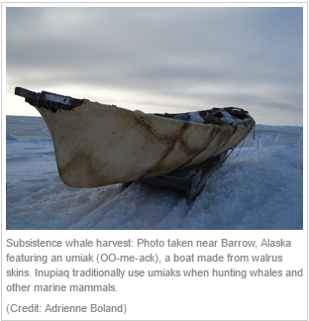
2b. Treatment of marine mammals
GA did not determine consensus
Challenging issue as consumption varies widely
Exposure may also vary widely
Options raised in GA
Establish a consumption threshold
Differentiate between nearshore and marine foraging species (FCR v. RSC)
Notes:
Might mean that some marine mammals are in the FCR (seals) due to habitat preferences while migratory marine mammals (whales) are in the RSC

Slide 5
What does the ADF&G data tells us?
Consumption varies across the state
Varies by species

Slide 6
Questions to consider
Should the consumption of marine mammals be considered in the HHC formula- discussion to date indicates YES.
If so, does the consumption of marine mammals equate to consumption of fish/aquatic life (part of FCR)
Yes/No?
1:1 relationship or something else?
If not, then is it adequately addressed when considered part of the RSC?

Slide 7
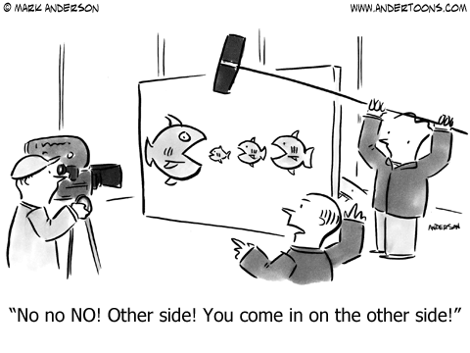
Recommendations on the Tx of Marine Mammals
Consensus?
Dissenting opinion?

