Slide 1

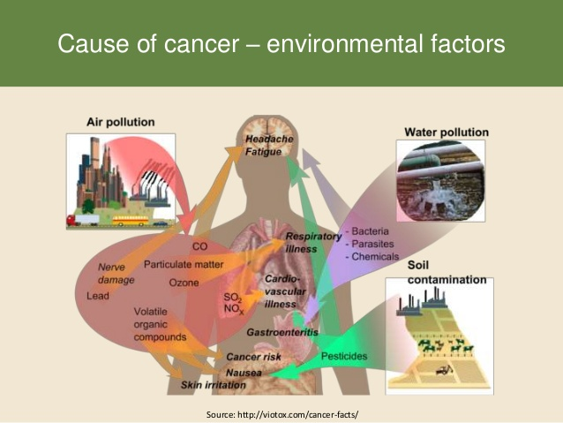
Issue 4: Cancer Risk Factor
Does not appear to be consensus
Support for use of highest value possible
Based on high rates of cancer in Alaskan Natives
Support for status quo based on lack of data demonstrating need
Concern that more stringent value will not result in lower contaminates in fish.

Slide 2
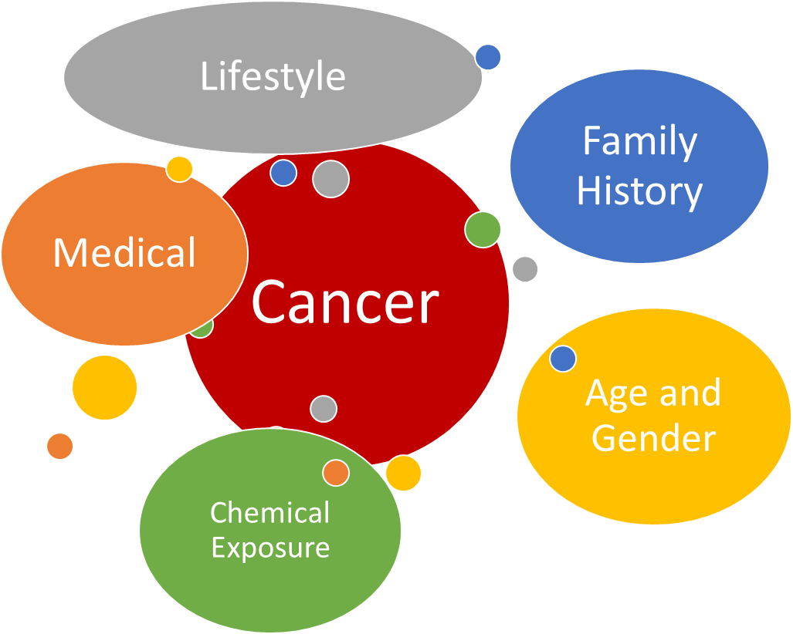
Incremental lifetime cancer risk level
The incremental lifetime cancer risk level (ILCRL) is the amount of additional risk that could be assigned to a pollutant.
Adds another layer of protection to humans beyond the toxicity factor- using it drives criteria lower
Environmental sources = 2% of cancer mortality rate
ILCRL

Slide 3
Cancer in AK
DHSS/ANTHC point of view
DEC posed a series of questions to DHSS/ANTHC in regards to cancer and exposure from environmental sources
See handout

Slide 4
Risk Management: Incremental Lifetime Cancer Risk Level
Allowable cancer risk level range from
1 in 100,000 (10⁻⁵) or 1 in 1,000,000 (10⁻⁶)
And must not exceed 1 in 10,000 (10⁻⁴) for those who eat more fish than others
“EPA understands that fish consumption rates vary considerably, especially among subsistence populations, and it is such great variation among these population groups that may make either 10⁻⁶ or 10⁻⁵ protective of those groups at a 10⁻⁴ risk level.”
EPA (2000) P. 2-6

Slide 5
Recommendation
Consensus?
Dissenting Opinion?

