Slide 1
Contaminant Levels in Alaskan Populations and Marine Mammals

Slide 2
Talking Points
Which chemicals should we consider for RSC or at all?
  See white paper distributed by Brock
  Which chemicals are relevant to Alaska?
    E.g. In the U.S. all uses of toxaphene were banned in 1990
  Which ones do not have an RfD
    E.g. p-DDE has an oral cancer slope factor but no RfD
    PCBs have a CSF but only some Aroclor mixtures have an RfD
Contaminants’ levels can be elevated in MM tissues
  What species/tissues are the most consumed?
Alaska populations consuming marine mammals can show elevated body burdens of contaminants
  They may be exposed to levels considered “unsafe”
  How does the concept of RSC apply to these populations?

Slide 3
CONTAMINANTS LEVELS IN MARINE MAMMALS

Slide 4
Contaminants in MM tissues
Many contaminant have been measured in MM tissues:
  Cadmium
  Mercury
  Cis-Chlordane
  Oxy-chlordane
  Heptachlor
  Heptachlor epoxide
  HCB
  HCH
  PFCs
  PBDEs
  PCBs
  DDTs
  (PAHs in clams?)
Levels are variable depending on
  Location/habitat
  Species
    Age, sex, tissue type

Slide 5
Concentrations Variations with Animals’ Sex
Male to Female Ratio for some Contaminants Concentrations in Beluga Whale Tissues
Generally, males seem to accumulate higher contaminant levels
Limitation: No age information
Hoguet et al. 2013, Krahn et al. 1999
Notes:
Male seem to generally accumulate more chemicals but variation due to age and location in inknownHoguet et al. 2013 Krahn et al. 1999

Slide 6
Concentrations Variations with Animals’ Age
Mercury in Harbor Seal Liver and Heart

Slide 7
Concentrations Variations with Tissue Type
Mercury in Harbor Seal liver and heart
Seals were from Kodiak and Prince William Sounds
Liver
2 orders of magnitude
Heart
N=80
N=17
N=38
Marino et al. 2011

Slide 8
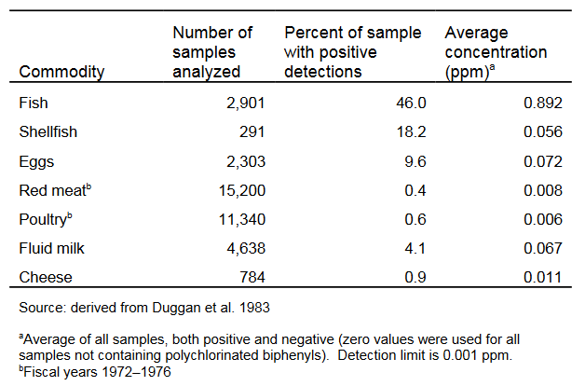
PCB Residues in Domestic
Raw Foods for Fiscal Years 1969–1976
ATSDR. 2000. PCB Toxicological Profile

Slide 9
Concentrations Variations with Tissue Type
Median PCB Levels in Bowhead Whale Tissues (n=5)
FDA’s Tolerance Level in Fish = 2 ppm (0.2-3.0 ppm PCBs for all other foods)
Fish from previous slide ~ 900 ppb
Shellfish from previous slide
Hoekstrsa et al. 2005, O'Hara 2005

Slide 10
Concentrations Variations with Species
Median PCB Levels in MM from Various Locations
FDA’s Tolerance Level in Fish
N=10,10, 11, 8, 20
N=14, 12, 25
N= 6, 14, 10
N= 5, 3, 20
N= 7
Krahn et al. 1999, Hoekstra et al. 2003, o'Hara et al. 1999, Seagars et al. 2000, Struntz t al. 2000, Kuckllick et al. 2002

Slide 11
HUMAN EXPOSURE TO CONTAMINANTS

Slide 12
Exposure of Arctic Populations
Arctic populations generally show higher levels of persistent contaminants than people from lower latitudes
  Contribution of their subsistence diet
  Levels vary with age, sex, location

Slide 13
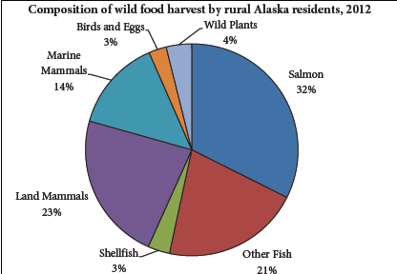
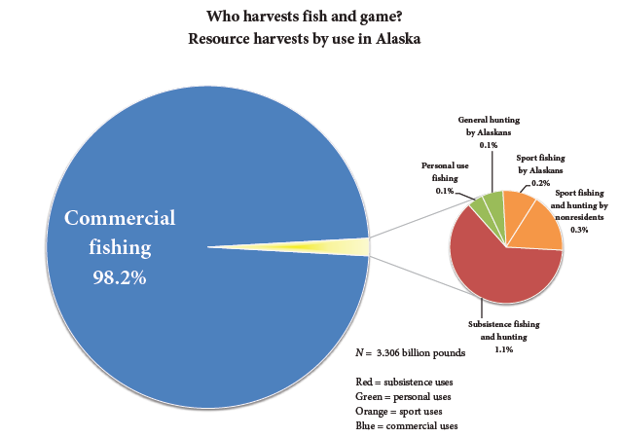
Subsistence in Alaska
From Alaska Department of Fish and game, Division of Subsistence. 2014. Subsistence in Alaska: A Year 2012 Update

Slide 14
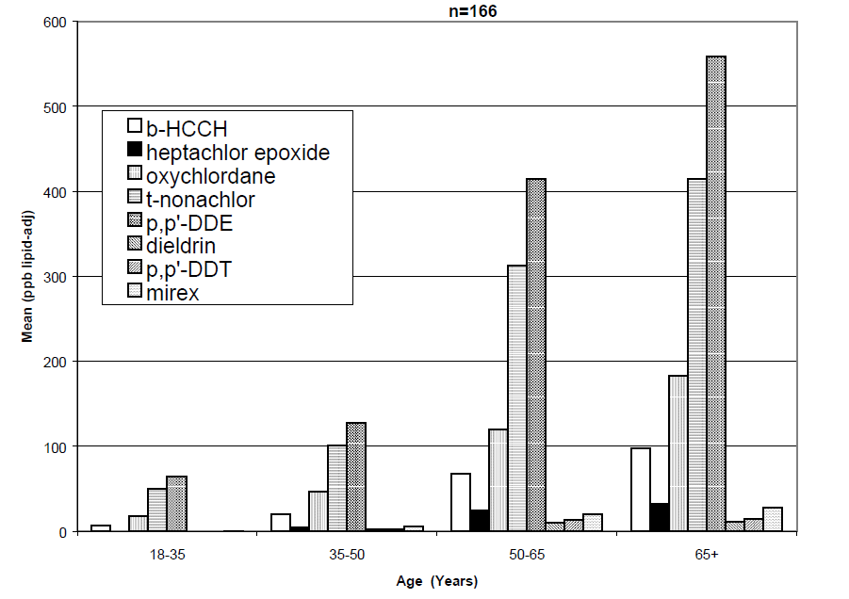
Mean Pesticide Levels by Age in 5 Aleutian and Pribilof Villages, AK 1999
Comparison with NHANES (‘99-’00)
Most pesticides were not detected in NHANES subjects
  Sample size ~ 600-700 for each age category
NHANES 1999-2000, Geo Mean (ppb)
 | 12-19 y.o. | >20 y.o.
ẞ-HCH | ND | 0.087
Heptachlor Epoxide | ND | ND
Oxychlordane | ND | ND (12.9 in 01-02)
t-Nonachlor | ND | 20.8
p,p’-DDE | 118 | 287
Dieldrin | ND | ND
p,p’-DDT | ND | ND
Mirex | ND | ND

Slide 15
Blood Mercury in Alaska Native women* vs. NHANES III
*Berner 2005
Today about 0.7ppb
n = 205
n = 1928
Notes:
?

Slide 16
Hair Mercury Levels
Subsistence v non-subsistence diet
Mean hair mercury level in subsistence food users is 7.6-fold the level of their non-subsistence counterpart
1.45 ppm (Range:0.32-4.00 ppm) v 0.19 ppm (Range: 0.03 to 0.43 ppm)
Rothschild, 2002

Slide 17
Aleutian/Pribilof WCBA and AMAP maternal plasma, 1994-1996

Slide 18
Median PCB Levels by Age and Sex

Slide 19
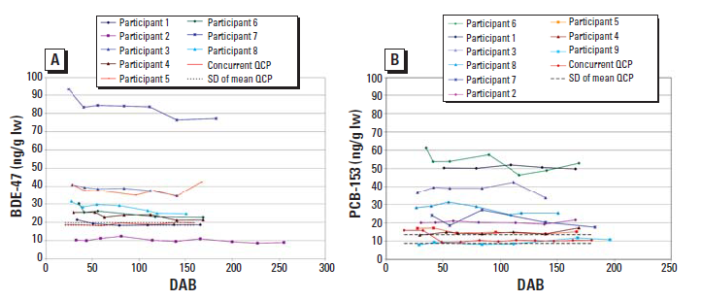
Infant Exposure Through Breastmilk
Infants can be a significantly exposed to POPs through breast milk
BDE-47 (A) and PCB-153 (B) levels in breast milk collected 6–24 weeks after birth.
Hooper et al. 2007

Slide 20
DIETARY INTAKE
(PCBs and Mercury)

Slide 21
Estimated Daily Dietary Intake of PCBs in the US
Year | Dietary intake (µg/kg body weight per day)
 | Adult | Toddler | Infants
1986–1991 | <0.001 | 0.002 | <0.001
1982–1984 | 0.0005 | 0.0008 | 0.0012
1981–1982 | 0.003 | ND | ND
1980 | 0.008 | ND | ND
1979 | 0.014 | ND | ND
1978 | 0.027 | 0.099 | 0.011
1977 | 0.016 | 0.030 | 0.025
1976 | Trace | ND | Trace
 | ATSDR (2000). Estimated intakes are based on an average "total diet" composition (which varies slightly) and not on individual food items. Average body weights are assumed to be 9 kg for infants, 13 kg for toddlers, and 70 kg for adults. Accordingly, the average dietary intake for 1982–1984 would be 0.0108 μg, 0.0104 μg, and 0.035 μg for the infant, toddler, and adult, respectively.

Slide 22
Safe PCB Health Criteria
Agency | Value | Comment
FDA | 0.2-3.0 ppm (all foods) 2.0 ppm (fish) | Tolerance Level
WHO FAO | 6.0 µg/kg per day 12.8 mg/month/person | Allowable daily intake
EPA - IRIS | CSF = 2.0 per (mg/kg)/day | Upper bound of the Oral CSF for high persistence PCBs [Central estimate is 1/(mg/kg/d)]
EPA - IRIS | RfDs | Developed for Aroclor 1016, Aroclor 1248, and Aroclor 1254
ATSDR | Chronic MRL = 0.02 μg/kg/d | Aroclor 1254

Slide 23
Health Risks Associated with
a Consumption of 6 oz/d?
Median PCB Levels
Cancer risk of 10⁻²
FDA’s Tolerance Level in Fish
For a 6 oz daily consumption (70 kg adult)
Cancer risk < 10⁻⁴ for a tissue concentration < 20 ppb ww
The MRL will be exceeded for a concentration > 8 ppb (Assuming 100% Aroclor 1254)

Slide 24
Acceptable Mercury Dose
Harbor Seal Liver
Acceptable Hg intake: 0.4 μg/kg BW/d
  For a 70 kg adult ⇨ 28 μg/d
Median [Hg] in PWS Liver: 8 μg/g
Safe consumption
3.5 g/d
106 g/month
3.7 oz/month
~ 4 oz/month is likely exceeded

Slide 25
Conclusion / Questions
In marine mammals, contaminant concentrations
  Can be elevated
  Vary widely with species, age and especially tissue type
    The concept of trophic level is insufficient to characterize accumulation in MM
    How to reconciliate this with the concept of RSC?
    How to deal with the large variability observed within species?
Because of their subsistence life style, Arctic populations tend to be more exposed to contaminants than the general population
    They might be regularly exposed to some chemicals at levels exceeding what is considered safe
    How does the RSC apply?

