Slide 1

Water Quality Standards
Human Health Criteria
Technical Workgroup
Meeting #9
Alaska Department of Environmental Conservation
Division of Water- Water Quality Standards
December 15, 2016

Slide 2

Webinar instructions:
For audio please dial: 1-800-315-6338
Access code: 51851
Note that all lines will be muted during the presentations
Public testimony will be taken at the end of the webinar.
PLEASE BE RESPECTFUL OF ALL PARTICIPANTS

Slide 3

Purpose of Technical Workgroup
Provide technical feedback on issues associated with development of human health criteria (HHC) in state water quality standards
  Develop a Summary Report
Identify key sources of information that may be applicable to the process
Ensure a variety of stakeholder voices are heard
Notes:
Over the new few months DEC will provide you with information on this issue, how other states have acted and the information/process they used, and potential options DEC has identified. A final Workgroup report will be generated based on the comments generated over the course of this process.
DEC will use this report to inform our decision-making process as we move forward in our revisions to the HHC

Slide 4
Recent HHC Decisions: Washington-EPA
EPA has made a final determination on proposed WQS
  Approved CRL of 10⁻⁶
  Approved FCR of 175
  Approved 14 HHC
  Disapproved and promulgated 99 HHC
    Based on WA use of BCF instead of BAF
    Based on WA use of RSC of 1
    EPA modified WA RSC from 1 to 0.5 because WA included anadromous and marine species
  Withdrew proposed criteria for arsenic, dioxin, and thallium
    Technical concerns- 2018?
Notes:
DEC is providing you with this information for reference only- should not affect your recommendations because EPA’s action is based on both scientific and science policy decisions.
It is my understanding that Ecology and several stakeholders are considering whether to bring suit as a result. Probably will not know more until 2017.
I’m happy to provide you with a copy of EPA’s letter and summary of actions taken.

Slide 5
Recent HHC Decisions: Idaho
Idaho submitted final WQS to EPA on 12/13
  Adopted CRL of 10⁻⁵
  Adopted FCR of 66.5
    Included anadromous species, tilapia, and several species of marine shellfish not found in state waters
    Based on mean (70th percentile) of sub-population (Nez Perce tribe) with highest consuming populace
      Protective of 95th percentile of general population
    Applies an RSC of 0.2-0.8 with no adjustment for inclusion of marine species
Notes:
DEC is providing you with this information for reference only- should not affect your recommendations because EPA’s action is based on both scientific and science policy decisions.
It is my understanding that Ecology and several stakeholders are considering whether to bring suit as a result. Probably will not know more until 2017.
I’m happy to provide you with a copy of EPA’s letter and summary of actions taken.

Slide 6
Question: Where do Marine Mammals Fit In?
Context: The Technical Workgroup has been grappling with how to address the consumption of marine mammals in the HHC formula
  Identified the BAF/BCF as one place where they can be accounted for.
  The bioaccumulation values provided by EPA may/may not have considered the consumption of marine mammals.
Dr. Frank Gobas
  Faculty at Simon Fraser University
  Author of numerous papers on food web bioaccumulation models
  Instrumental in developing EPA recommended national BAF values

Slide 7
Questions posed to Dr. Gobas (Slide 1 of 2)
What marine mammals are bioaccumulating contaminants from waters under CWA jurisdiction (i.e. near shore marine, estuarine, and fresh water)?
Corollary: Do some marine mammals have a fraction of their body burden that comes from CWA jurisdiction waters? How would we get at fractional uptake?
How would we incorporate consideration of marine mammals in EPA’s current BAF methodology?
Improving and Protecting Alaska's Water Quality

Slide 8
Questions posed to Dr. Gobas (Slide 2 of 2)
How do we take into account variation in bioaccumulation by life stage or season in developing BAFs for use in AWQC development?
Do you have any thoughts as to how we would deal with differences in diet and bioaccumulation across Alaska in developing AWQC?
What are we missing?
Improving and Protecting Alaska's Water Quality

Slide 9
Question: What Chemicals with HHC Are Documented In Alaska?
DEC Whitepaper
  DEC reviewed the following:
  EPA Toxic Release Inventory (TRI)
  DEC Contaminated Sites database
  DEC wastewater discharge permits
PAH/metals are common in permits and C-Sites
Limited number of highly bioaccumulative chemicals identified (>5000 BAF value per Toxics Control Substances Act)
Notes:
This discussion is an outcome of the last meeting in which the Workgroup wanted additional information on exactly what chemicals with HHC have been documented to exist in Alaska.
The reasoning was the workgroup wanted to concentrate discussion on the practical rather than hypothetical.
The BAF value comes from the Toxics Control Substances Act.

Slide 10
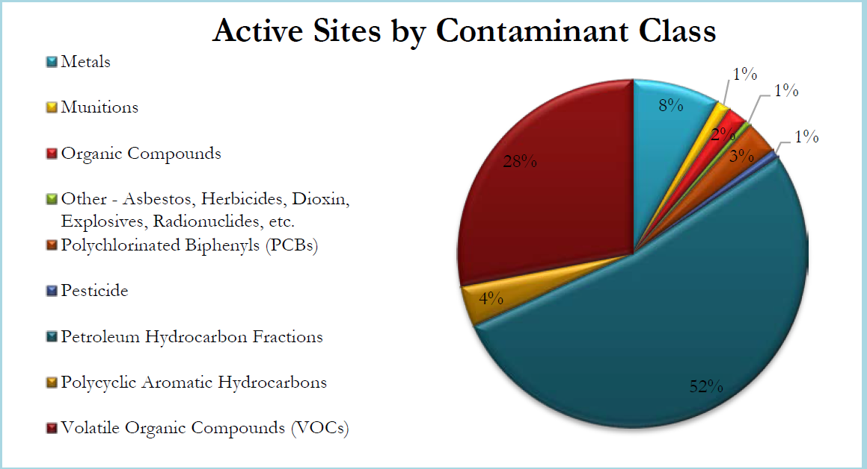
Which chemicals are we talking about?
  Petroleum/Organics
  Several metals/metalloids

Slide 11
USFWS/DHSS Comments

Slide 12
Discussion
BAF/BCF
  How does this information affect your recommendation to use BAF v. BCF?
    Your recommendations can be chemical-specific
  Application of BAF: Options
    Application of National BAF values for TL2-TL4
    Recalculate the ratio of national TL2-TL4 values based on AK FCR following ADF&G analysis of species consumed.
    Use of TL4 alone (WA)
    Should DEC address highly bioaccumulative chemicals differently than other chemicals?
      E.g., Aldrin, Hexachlorobenzene, Toxaphene
Improving and Protecting Alaska's Water Quality
Notes:
EPA offers guidance on how BAF values can be recalculated according to lipid content, food webs and dietary preferences.
Modifying the BAF based on FCR is called the Model-derived Food Chain Multiplier. Allows states to recalculate based on the representative food web.
The other way to modify the BAF is to modify the values by recalculating the BIOMAGNIFICATION factor

Slide 13
Discussion
Fish Consumption (FCR)
Does this affect your recommendation regarding the target population?
  Should DEC consider Rural as the general or consider a sub-pop. of Rural?
  Does this information affect your recommendation whether to include/exclude anadromous species?
  Does this information affect your recommendation whether to include/exclude marine mammal species?

Slide 14
Discussion
Relative Source Contribution (RSC)- applies to non-carcinogens only
Does this information affect your recommendation regarding how we may apply RSC in general?
  How does the relationship between FCR and RSC affect your decision(s)?
Does this affect your recommendation regarding how we may apply RSC for highly bioaccumulative chemicals?
  E.g., Aldrin, Hexachlorobenzene, Toxaphene
  Should DEC consider using a different RSC for these chemicals?

Slide 15
ADF&G Update

Slide 16
Next steps
Draft workgroup report due to DEC Leadership on Jan 9th
HHC Workgroup Mtg #10 (end of January?)
  ADF&G FCR percentiles
  Marine Mammals Discussion
HHC Workgroup Mtg #11 (February-Early March)
  Implementation tools

Slide 17
Public Comments

Slide 18
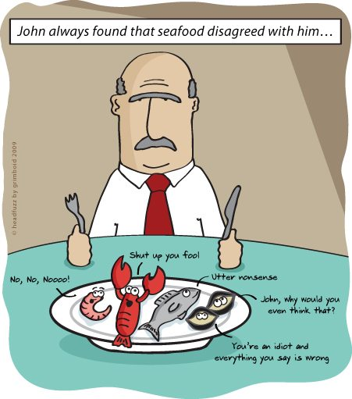

Slide 19
Background Info: Federal data
Toxic Release Inventory (TRI) tracks releases into various media
Reporting is dependent on the type of industry
TRI identified 55 releases of toxic chemicals into water
  20 of these releases were COCs with HHC
  Database does not differentiate between surface or groundwater
  Three releases were carcinogenic (one dry cleaning agent, two petroleum-based)
  Results were similar to previous years

Slide 20
Background Info: State data (Contaminated Sites (C-Sites))
C-Sites focus on groundwater contamination
  Coordinate with DEC-Water when there are concerns regarding surface water
C-Sites tracks 100’s of contaminated sites around the state
  Military installations: leading source of C-Sites
  Petroleum Industry: 2
  NOTE: Majority of all sites are petroleum-related
30 chemicals with HHC
18 Carcinogenic chemicals

Slide 21
Background Info: State date: APDES Program
Alaska Pollutant Discharge Elimination System (APDES)
Regulates the discharge of pollutants into Alaska’s waters
Staff reviewed both individual and general permits
  146 Individual permits
  General permits apply to a specific group or category of discharges
    Cook Inlet Oil and Gas GP (industry and geographic location)
    Placer Mining GP (industry)
    Number of GPs: potentially 100’s

Slide 22
Background Info: Common chemicals of concern
Arsenic- Technical and Policy issues
  AK waters withdrawn from HHC application
  Potential for new criteria to be an order of magnitude more conservative
Cyanide- Technical issues
Methylmercury- Technical and Policy issues
  Based on fish tissue rather than water column
  Background concentrations in AK waters may exceed recommended criteria
PCBs- Technical issues
Notes:
Technical issues refers to the fact that method detection limits and current treatment technology may not be able to detect or treat the chemical. Presents compliance concerns

Slide 23
Background Info: “Problem chemicals”
“Major” dischargers are required to sample for a much larger suite of chemicals
  “Major” applies to a limited number of permits (≥ 1 million gallons)
  In many cases the current method detection limit (MDL) technology may not be accurate enough to detect the presence of a particular chemical
  Majority of chemicals with MDL issues are not manufactured in AK
    Pentachlorobenzene

