Slide 1

Water Quality Standards Human Health Criteria Technical Workgroup Meeting #11
Alaska Department of Environmental Conservation
Division of Water- Water Quality Standards
April 12, 2017

Slide 2

Webinar instructions:
For audio please dial: 1-800-315-6338
Access code: 51851
Note that all lines will be muted during the presentations
Public testimony will be taken at the end of the webinar.
PLEASE BE RESPECTFUL OF ALL PARTICIPANTS

Slide 3

Purpose of Technical Workgroup
Provide technical feedback on issues associated with development of human health criteria (HHC) in state water quality standards
Develop a Summary Report
Identify key sources of information that may be applicable to the process
Ensure a variety of stakeholder voices are heard
Notes:
Over the new few months DEC will provide you with information on this issue, how other states have acted and the information/process they used, and potential options DEC has identified. A final Workgroup report will be generated based on the comments generated over the course of this process.
DEC will use this report to inform our decision-making process as we move forward in our revisions to the HHC

Slide 4
Meeting Outline
Address loose ends
Fish consumption rates
Other thoughts?
Options for the Treatment of Marine Mammals in the HHC formula
Implementation of HHC

Slide 5
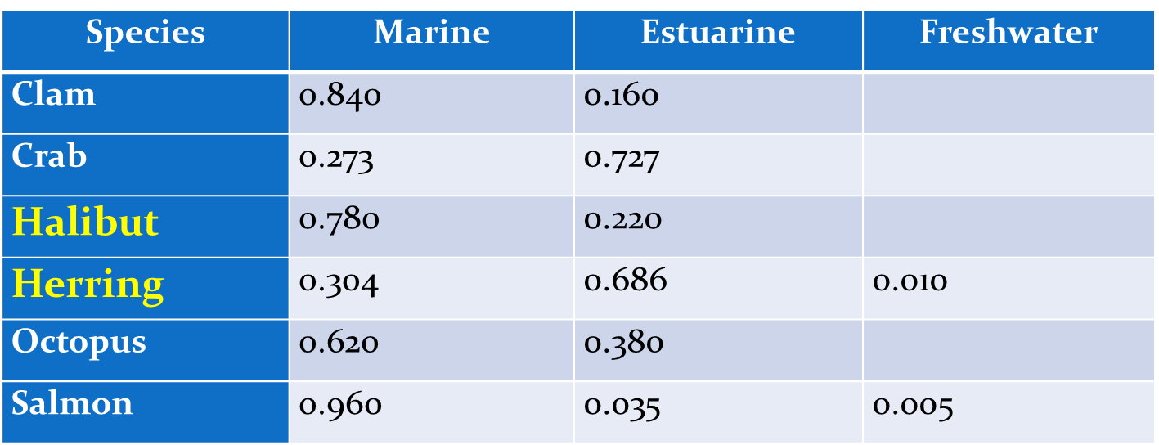
What else should DEC consider in the FCR process?
Does the TWG have suggestions regarding other ways to analyze the data?
Inclusion of certain marine species noted in the NHANES study (halibut and Herring)
Inclusion of seal and sea lion
These habitat appointment values are based on national data- might not necessarily be applicable in Alaska.
Notes:
At the last meeting there was a request for DEC to take another look at the species used in the NHANES study and include those species as part of the ADF&G analysis. DEC has information on consumption but not information on habitat appointment values specific to Alaska
So far we have only discuss full inclusion (species in white) or exclusion (marine species of fish other than salmon).

Slide 6
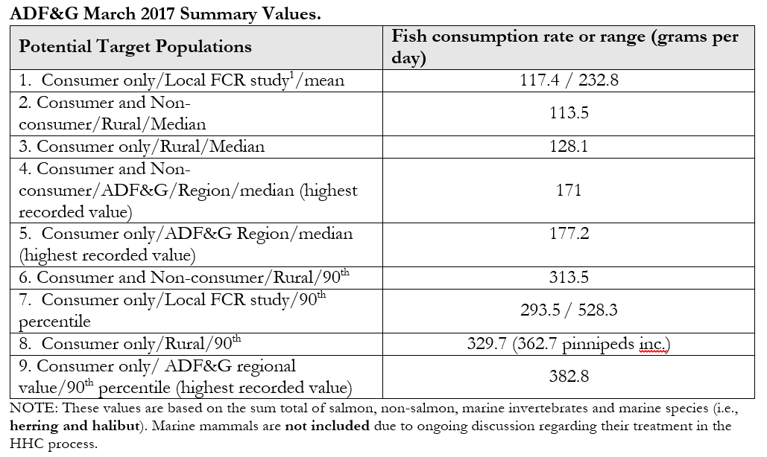
These are tribal study values
Previously discussed by TWG
Notes:
NOTE: All regions reported consumption of halibut . 0.3 gpd Per capita in Arctic Alaska to 45.6 gpd in Southeast AK.
Focus of the TWG to date as been Rural/Consumers/90th percentile – 329.7 g/day. Adjusted from 318.4 previously.
ADF&G Rural value is slightly above the 90th percentile value for Cook Inlet (local study) but significantly lower than preliminary data from Sun’aq tribe. The Sun’aq study.
There’s lots of policy issues in play at the moment that may add additional sidebars to the choices such as tribal treaty rights and Idaho’s approval/disapproval.

Slide 7
TWG FCR Recommendations
Target Population?
Rural (90th) and simply note that dissention existed within the group?
Rural (90th) and Urban (90th?)
Regional FCR using 90th?
Something else…
Until we have identified the population of concern (i.e., target population) we cannot make other conclusions regarding the FCR.
Notes:
DEC tried to present the “sidebars” affecting your decisions in the technical analysis paper. Essentially, we are confirming that the TWG is in agreement on this issue- or if there is dissention among members of the group

Slide 8
Discussion
Improving and Protecting Alaska's Water Quality

Slide 9
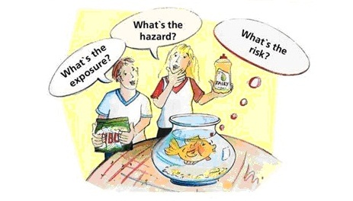
Issue #3. Treatment of Marine Mammals in the HHC Formula
DEC provided the TWG with two documents for consideration
Options to Consider Regarding the Treatment of Marine Mammals in the HHC formula
Vetted by Drs. Deglin and Verbugge
Species-specific marine mammal consumption information from the CSIS database
Included in the ADF&G FCR analysis
Notes:
Word of thanks to Lori and Sandrine for helping me narrow down the range of viable options for the workgroup to consider.

Slide 10
Marine mammals and the HHC Formula
(1) Fish Consumption Rate
Exclude
Include certain species or percentages of those species
Full inclusion
If you exclude you are consistent with EPA policy and practice.
If you include you should expect a considerable amount of research regarding tissue-specific bioaccumulation factors will be required for scientific defensibility.
Notes:
Essentially- the take home message is if you aren’t going to do it right, you are not necessarily going to be able to scientifically defend your decisions.

Slide 11

Marine Mammal Options
(2) Bioaccumulation
If you exclude marine mammals
Use percentage of Trophic Level 2-4 (EPA methodology)
Use Trophic Level 4 (Washington)
If you include marine mammals
Will result in a range of tissue-specific BAFs
Would need to establish tissue-specific estimates of consumption
Ecomare.com

Slide 12
Marine Mammal Options
(3) Relative Source Contribution
Determined that RSC value of 0.2 is likely to be appropriate regardless of whether you adopt marine mammals or not.
Based on amount of uncertainty around exposure through the consumption of marine mammals and need to stay below the reference dose.
Potential for SSC using an adjusted RSC should marine mammal consumption be severely limited (i.e., interior projects)

Slide 13
Discussion
Note that DEC re-ran the ADF&G data using pinnipeds
Pros/Cons of including marine mammal are information related
Lots of data saying that pollutants can exist
Toxicity is tissue-dependent
Degree of risk may vary depending on species and tissue consumed
Improving and Protecting Alaska's Water Quality

Slide 14
Implementation
DEC provided a whitepaper and scenarios using variations of the HHC formula
There are currently numerous tools available
Permitting Tools: Mixing zones, compliance schedules, intake credits
WQS: Reclassification, Site-specific criteria
New tools coming
WQS: Variances
Other options
Permitting Tool: Inclusion of Pollutant Minimization Plans

Slide 15
Magnitude, Duration, and Frequency
Magnitude: Numeric values
Duration: The specified time period in which magnitude is calculated
Generally based on chronic exposure
Carcinogen duration is 70- years.
Might be applied by looking at the average of a long-term dataset
Non-carcinogens vary depending on the chemicals
Might be applied by using the average over a 30 day period/year/”long term avg”
Frequency: Number of times you can exceed magnitude within a specific time period (i.e. duration).
Generally 1 in 3 year approach is used

Slide 16
HHC and Water Quality Assessments
Problem Statement: Pollutants with proposed HHC may be difficult to sample in the water column using existing technology
Use of fish tissue data may be useful as a second line of evidence
Exposure pathway approach (RfD *BW / FCR or DW Intake)
Fish Tissue sampling is not easily conducted due to low number of commercial labs
More research will be required before DEC can commit to a particular assessment or 303(d) listing determination process
Notes:
Washington Ecology is considering use of fish tissue data for all of the pollutants with HHC since those values apply bioaccumulation/bioconcentration values.

Slide 17
HHC and Permits
Reasonable Potential Analysis
May be appropriate to consider Total rather than Dissolved concentrations for many pollutants with HHC values
Recommended for methylmercury and metals
Unsure about POPs
Oregon has an approach that may be promising
Numerous tools currently available
Mixing zones (use average conditions of effluent and ambient waters)
Compliance Schedules
Intake credits

Slide 18
HHC and Water Quality Standards
Current regulations allow for the use of certain WQS tools when a designated use or criteria cannot be attained due to background “natural” conditions
Waterbody Reclassification
Site Specific Criteria
Natural Conditions regulations do NOT apply to human health criteria
Natural conditions regulations only apply to aquatic life
While a natural condition may exist, it does not necessarily mean that human health is protected when exposure occurs

Slide 19
New tools
Pollutant Minimization Plans (Permitting Tool)
Currently used for methylmercury in Oregon
Addresses source control when technology may not be applicable.
Works towards reducing the problem rather than simply rejecting the permit or changing WQS
Variances (WQS Tool)
Provides time to address the issue when there is not a remedy readily available
Applies to individual or general permits or waterbodies
Water Quality Standard change so the process is fairly stringent

Slide 20
Pollutants of concern
Arsenic (High natural concentrations)
Cyanide (Sampling issues)
Methylmercury (Tissue-based criteria)
PCBs (Sampling and Tx issues)
Bioaccumulative “legacy” chemicals (Sampling and Tx issues)
Mostly herbicides, insecticides, and pesticides
Each chemical has its own unique issues DEC needs to consider

Slide 21
Next steps for TWG Process and Report
Workgroup needs resolution on:
FCR value
Treatment of marine mammals
Workgroup Report
Skeleton draft is complete
Need input from TWG to draft dissenting opinions once they have reviewed the draft language
Notes:
DEC wants to finalize and public notice the TWG report this summer.

Slide 22

Public Comment

