Slide 1

Water Quality Standards Human Health Criteria Technical Workgroup Meeting #10
Alaska Department of Environmental Conservation
Division of Water- Water Quality Standards
February 28, 2017

Slide 2

Webinar instructions:
For audio please dial: 1-800-315-6338
Access code: 51851
Note that all lines will be muted during the presentations
Public testimony will be taken at the end of the webinar.
PLEASE BE RESPECTFUL OF ALL PARTICIPANTS

Slide 3

Purpose of Technical Workgroup
Provide technical feedback on issues associated with development of human health criteria (HHC) in state water quality standards
Develop a Summary Report
Identify key sources of information that may be applicable to the process
Ensure a variety of stakeholder voices are heard
Notes:
Over the new few months DEC will provide you with information on this issue, how other states have acted and the information/process they used, and potential options DEC has identified. A final Workgroup report will be generated based on the comments generated over the course of this process.
DEC will use this report to inform our decision-making process as we move forward in our revisions to the HHC

Slide 4
Meeting Outline
Address loose ends
Salmonid residence time in Alaska: ADF&G Sportfish summary
ADF&G Analysis of Community Subsistence Information System (CSIS) data and FCRs for Rural and ADF&G Regions
DEC Technical Paper regarding selection of a FCR
Options for the Treatment of Marine Mammals in the HHC formula

Slide 5
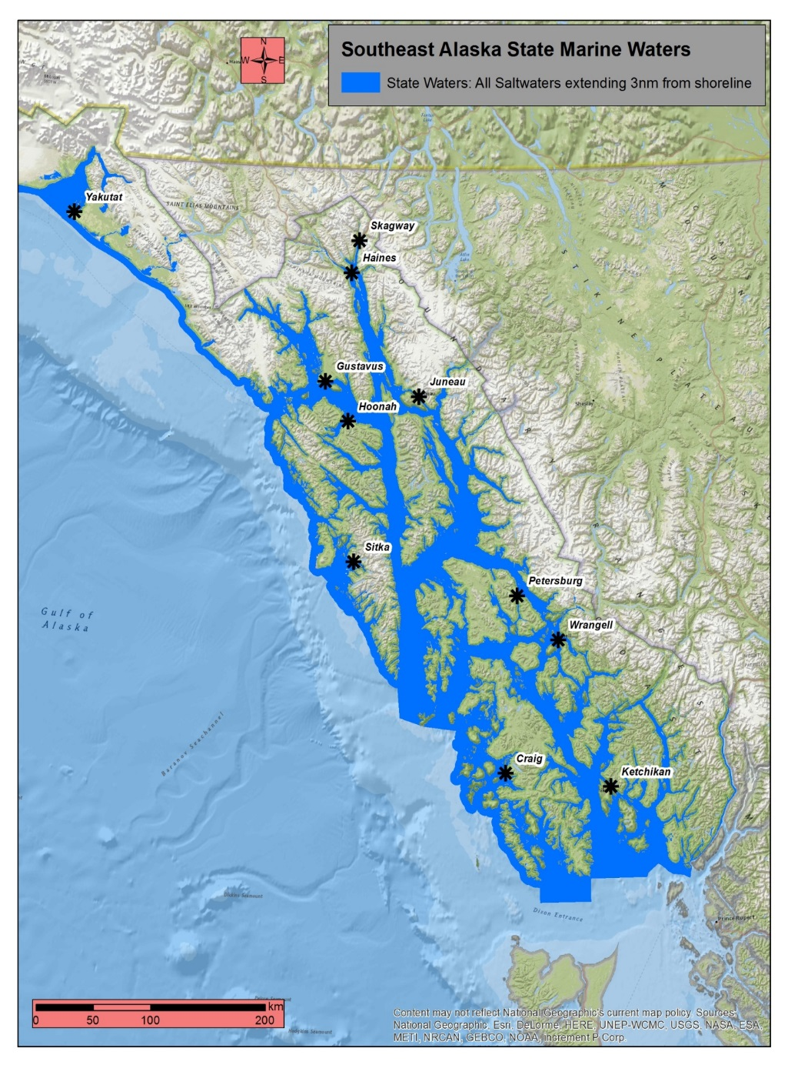
Issue #1. What information is available on salmonids regarding their lifecycle and residency time in Alaska’s waters?
Residence time is impossible to generalize for anadromous species due to species-specific traits
Salmon v. Trout (steelhead v. cutthroat) v. Char (Dolly Varden)
ADF&G Sportfish: There are Chinook stocks that spend nearly 100% of residence time in state waters in Southeast Alaska
Notes:
I was asked to inquire with ADF&G staff regarding specific data or research into residence time in state waters. The document you received is the informed opinion of the Research Coordinator in the SE office.
Majority should not be a surprise when it comes to salmonid bx. That said-it was interesting to read that Chinook stocks in SE may in fact have similar behaviors as stocks in Puget Sound when it comes to residence time. I did not inquire about stocks in Prince William Sound.
Questions?

Slide 6
Issue #2. ADF&G Community Subsistence Information System FCR study and DEC Technical Analysis
The TWG was provided with two documents for consideration
ADF&G Fish Consumption Rate Analysis
ADF&G analysis of species consumed as part of the larger analysis
DEC Technical Analysis of various FCRs in the HHC context
The DEC paper is to provide the context for what may or may not be viable options for the Workgroup to consider.
Notes:
My intent for developing the DEC document was to provide some context to the FCR values regarding what we have/have not discussed to date and EPA methodology or science policy “sidebars”.

Slide 7
ADF&G methods
108 recently surveyed communities (2008-2014) from all six AK regions
Dog food removed from analysis
Outliers identified as 2 standard deviations from community mean per species and/or twice the upper limit of suggested daily intake of fish/protein (340.2 gpd)
If outliers did not report sharing and community use patterns supported sharing, outlier harvest shared amongst community
Percentiles based on user group consumption levels (see ADFG TP261)
Harvested species, did not share
Used species, gave or received
Did not use species

Slide 8
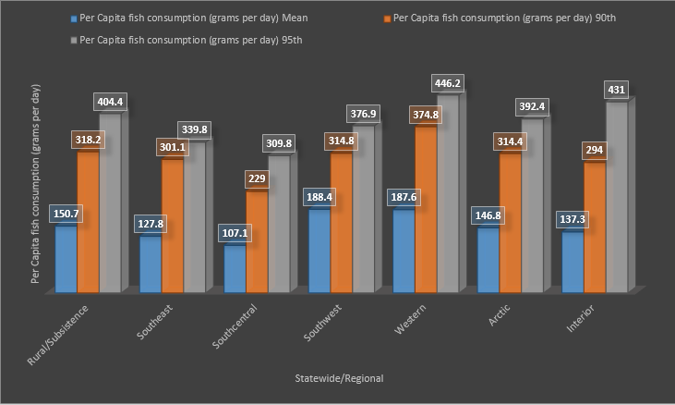
ADF&G 2017
Notes:
The graphs are the mean, 90th, and 95th percentile values. By Rural and by region. Depicts the range that we see across rural AK.
Note that these values are WET weight values. Method of processing could significantly change harvest v. actual weights.
Consumer/User only data
FW Fish, salmon and marine inverts.
Range of values across the state
Some regions have higher variance between mean and 95th percentile than others
Southwest (189 g/d)
Interior (294 g/d)

Slide 9
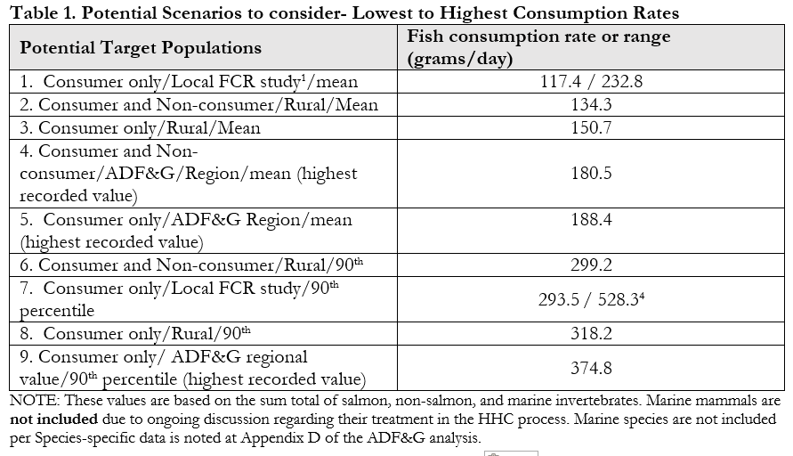
Notes:
NOTE: Values noted here are from the ADF&G FCR Summary. DEC notes that it may be more appropriate to replace mean with MEDIAN (50th percentile) values because the data is log-normalized.
Numbers 2, 4, and 6 are not likely to be viable options as they include both consumer and non-consumer data.
Focus of the TWG to date as been Rural/Consumers/90th percentile – 318.2 g/day.
Slightly above the Cook Inlet value but significantly lower than preliminary data from Sun’aq tribe.

Slide 10
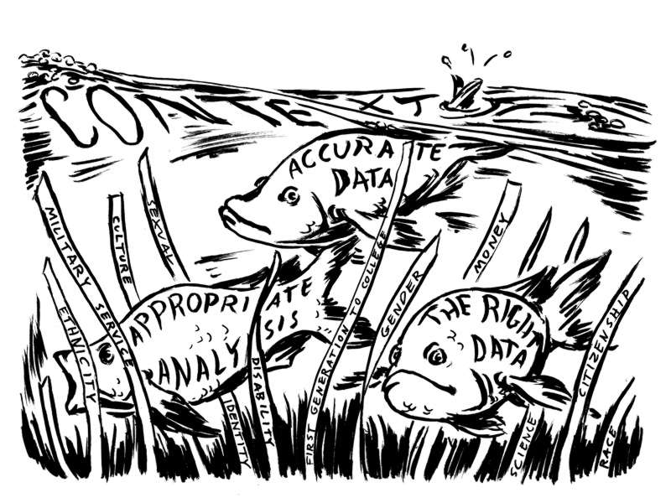
Questions
Is the data “good” / Tell us what we need to know?
Does the data need to be refined or re-analyzed to help answer the question?

Slide 11
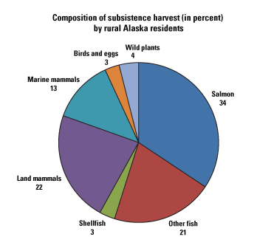
Questions
Is it really possible for a person to eat that much fish?
Harvest is reported as wet weight while consumption of dried/smoked fish is more typical.
EPA methodology calls for reporting wet weight values.
A limited number of people may be harvesting and then redistributing it across a network of households.
ADF&G 2010 Update
Notes:
Conversations with Seldovia indicate that this value is not surprising but rather fairly consistent with what they noted.

Slide 12

Questions: ADF&G v. Tribal data
Are the ADF&G methods and analysis comparable to that used in the contemporary tribal surveys?
Both datasets are based on dietary information obtained via an interview/survey process.
Potential differences in survey language/models depicting size/weight
ADF&G sample size was larger than Tribal surveys
May require additional discussion or an outside opinion to make a conclusion.
Notes:
The DEC report provides a brief summary of the mean, median, and 95th percentile values for the ADF&G and Seldovia datasets. Appears that ADF&G regional values are similar to that of tribal data when you consider the mean. 95th percentiles are slightly different if you look at consumer only data. Hard to determine what this could be attributed to.
ADF&G also conducted a more rigorous review of the Seldovia work independent of this analysis and came to different daily and yearly values but similar monthly values. ADF&G Methods are very likely to be somewhat different due to a variety of factors including the total sample sizes of the studies, language of the questions, models used to determine portion sizes, and treatment of outliers.
Essentially, the question may come down to which dataset is more appropriate for developing a statewide value. This issue came up in Idaho and continues to be under discussion. Alaska would seek to have some additional clarification on this before finalizing

Slide 13

ADF&G v. Tribal Data
How representative is the ADF&G data when compared with tribal data?
Discussed in Appendix B of the ADF&G report.
Some ADF&G regional datasets have higher representation of Alaska Natives than others.
Doesn’t necessarily mean the values aren’t statistically significant.
Scale matters when it comes to sample size

Slide 14
TWG FCR Recommendations
The TWG must make recommendations on the following:
Should the target population include All User groups or Consumers only?
The TWG previously discussed Consumers only data.
Should the target population be Alaska’s Rural population?
The TWG previously discussed and concluded Rural were high consumers.
Should the proposed target population be considered as the general population or sub-population?
The decision affects which percentile will be targeted (90th or 50th).
The TWG previously discussed treatment of the Rural as general population.
Notes:
DEC tried to present the “sidebars” affecting your decisions in the technical analysis paper. Essentially, we are confirming that the TWG is in agreement on this issue- or if there is dissention among members of the group

Slide 15
Discussion
Improving and Protecting Alaska's Water Quality

Slide 16
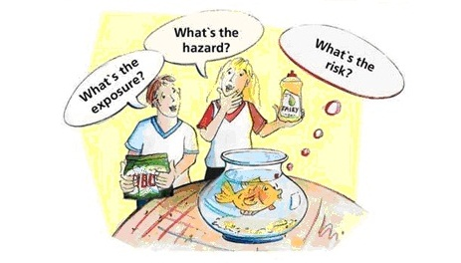
Issue #3. Treatment of Marine Mammals in the HHC Formula
DEC provided the TWG with two documents for consideration
Options to Consider Regarding the Treatment of Marine Mammals in the HHC formula
Vetted by Drs. Deglin and Verbugge
Species-specific marine mammal consumption information from the CSIS database
Included in the ADF&G FCR analysis
Notes:
Word of thanks to Lori and Sandrine for helping me narrow down the range of viable options for the workgroup to consider.

Slide 17
Issue to be discussed in further detail at Meeting #11

Slide 18
Next steps for TWG Process and Report
Workgroup needs to establish whether there is consensus on:
Statewide FCR value
If consensus is not reached- what are the dissenting opinions?
Treatment of marine mammals
If consensus is not reached- what are the dissenting opinions?
Workgroup Report
Skeleton draft is in place.
DEC will update with new recommendation language once FCR and marine mammal info once group has made decisions on those points
Need to get together with members of the workgroup to draft dissenting opinions
Notes:
DEC wants to finalize and public notice the TWG report this summer.

Slide 19
Next meeting: Treatment of Marine Mammals and Implementation of HHC in Water Pollution Control Programs (Permits/Assessments)
Early April?
Will send out Doodle poll
TOPIC: Implementation Tools and Issues
Draft whitepaper in progress
Additional information may be gleaned from Oregon/Washington

Slide 20

Public Comment

