Slide 1

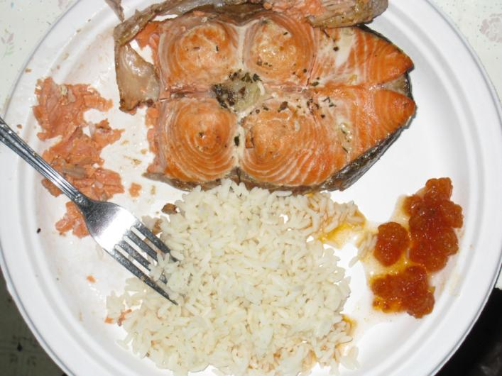
Mean Per Capita Harvest and 95th Percentile Per Capita Use for Fish and Seafood in Port Graham, Nanwalek, & Tyonek
James A. Fall
Marylynne L. Kostick
Division of Subsistence, ADF&G
Human Health Criteria
Technical Workgroup
Anchorage, AK
September 30, 2015
Meal of salmon, salmonberries, and rice, Sleetmute, Alaska

Slide 2
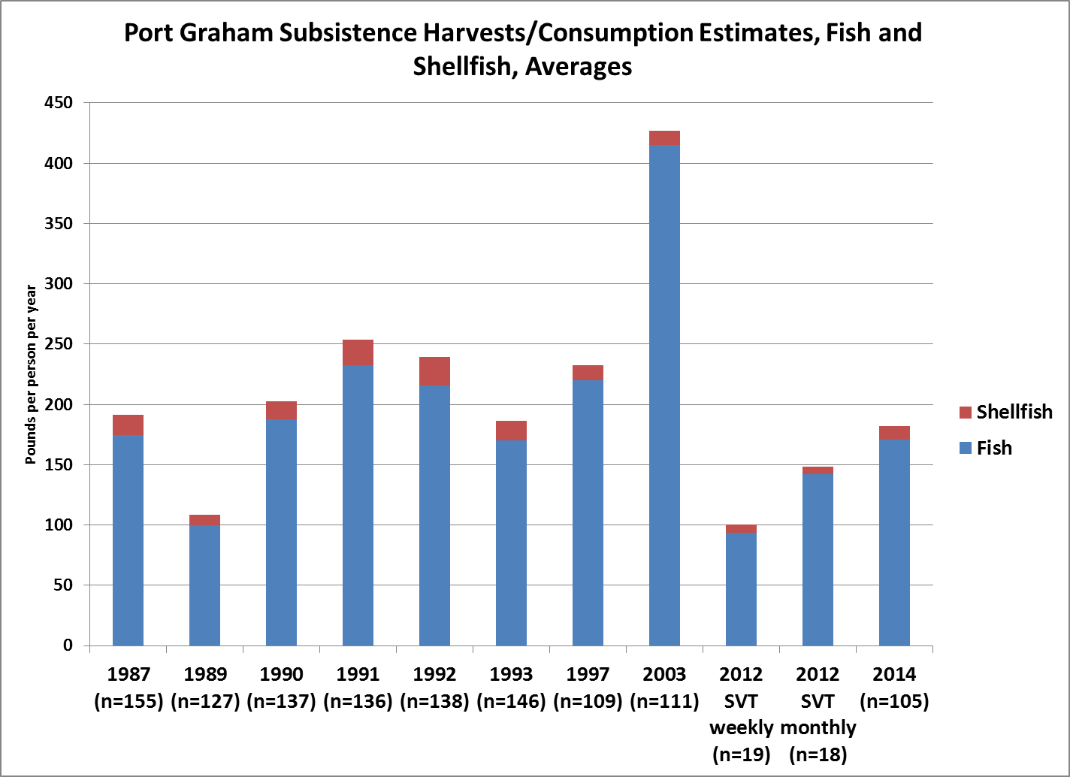

Slide 3
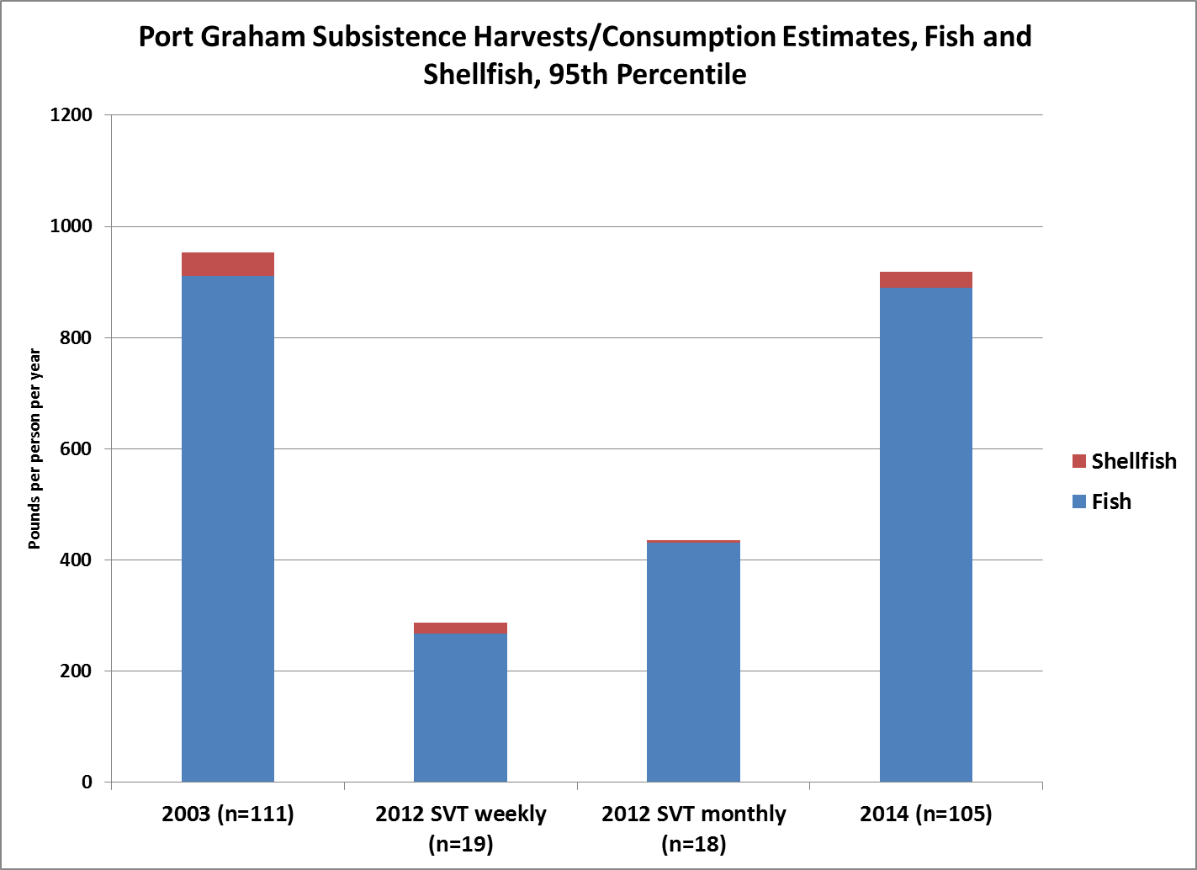

Slide 4
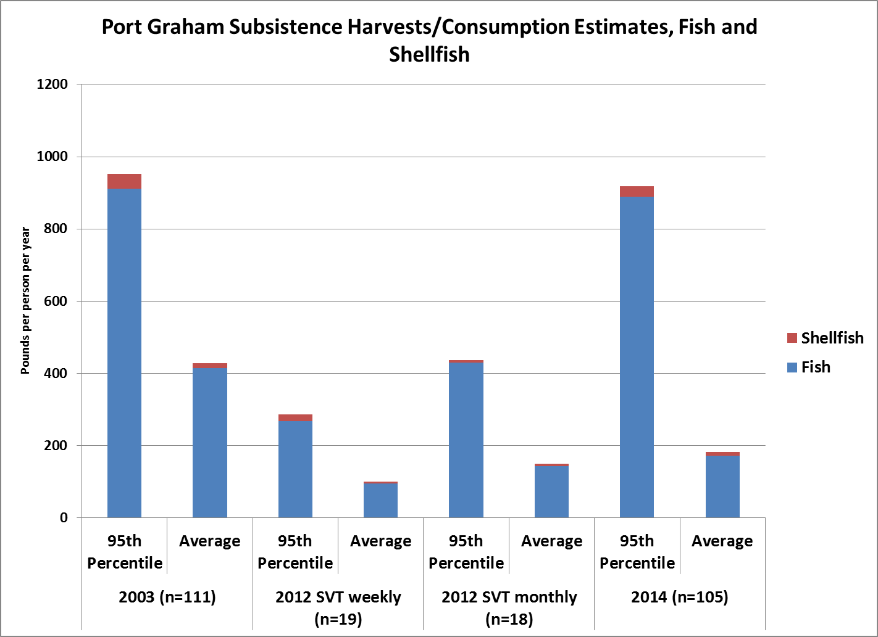

Slide 5
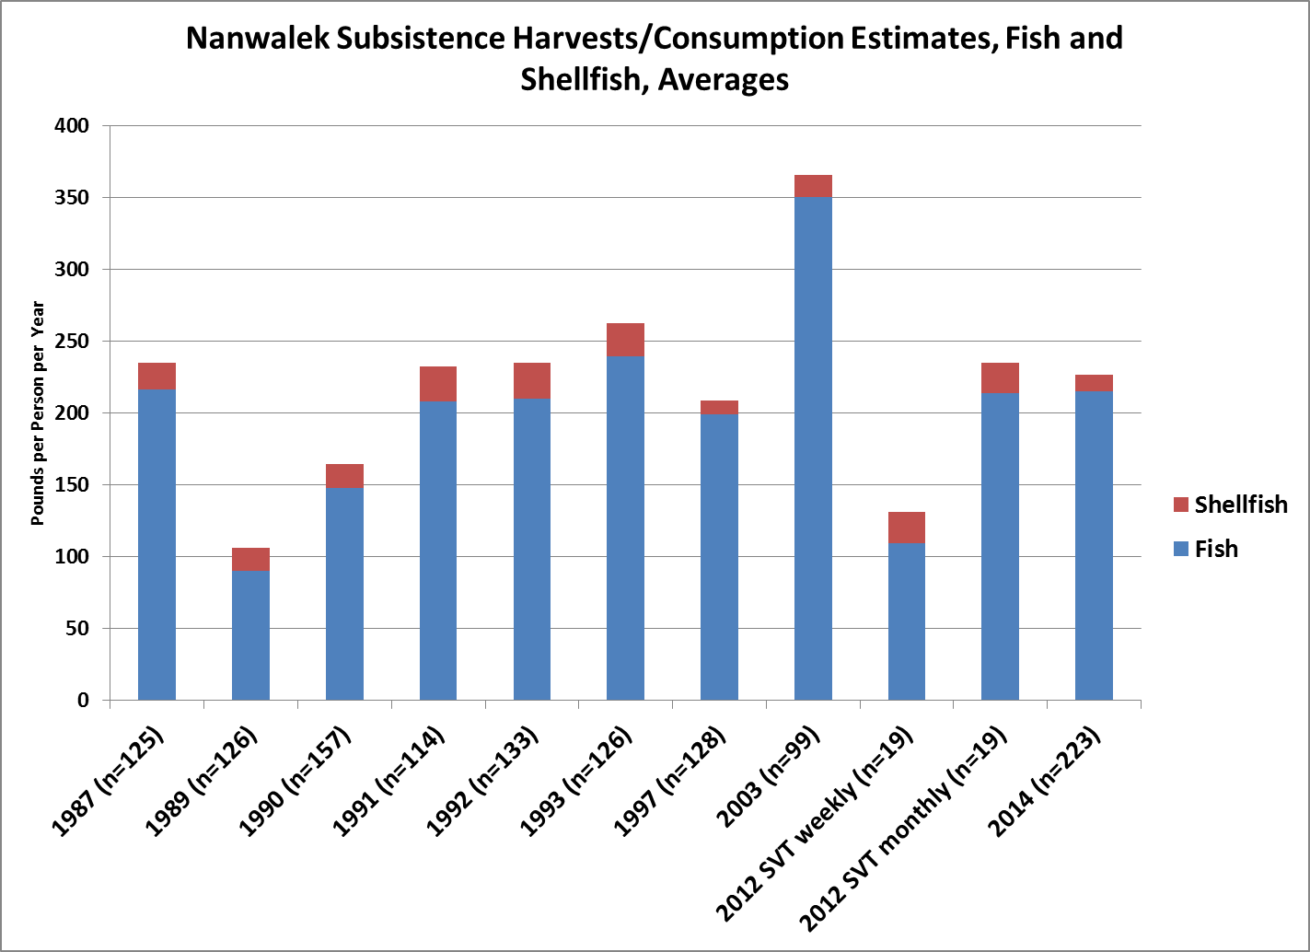

Slide 6
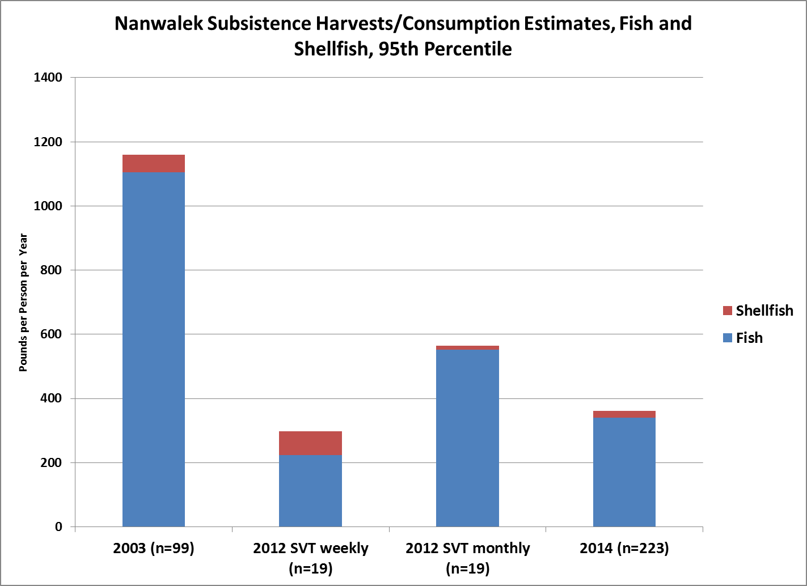

Slide 7
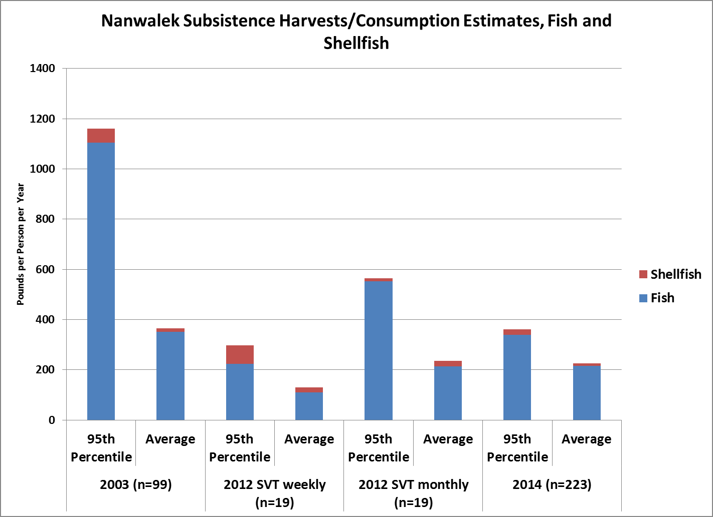

Slide 8
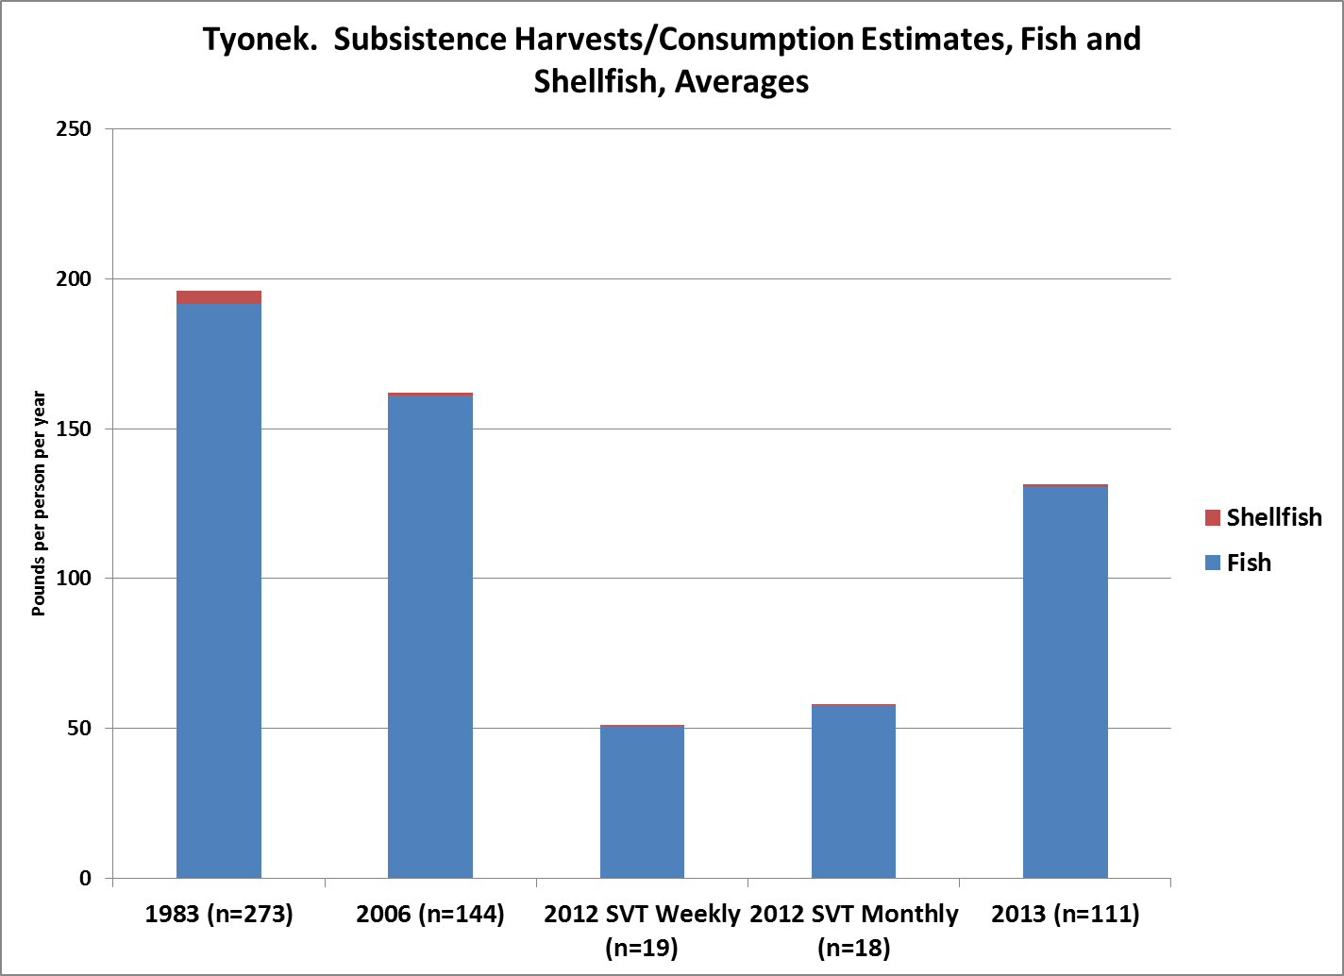

Slide 9
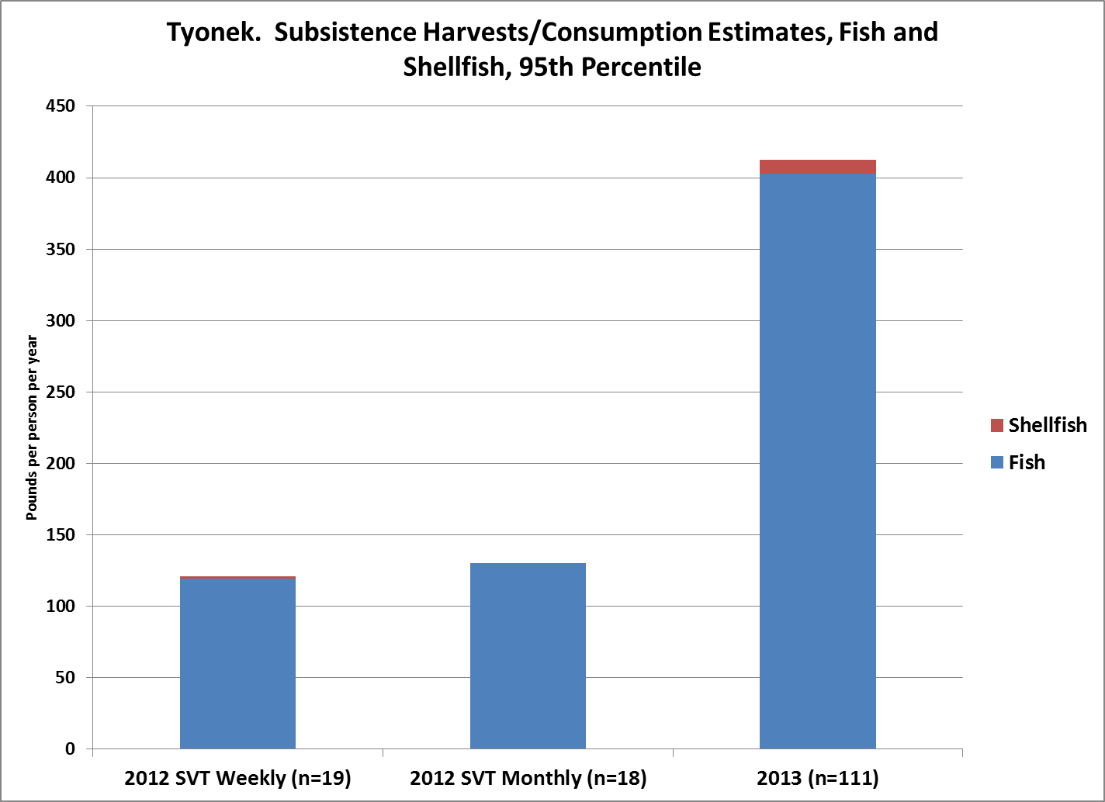

Slide 10
