Slide 1
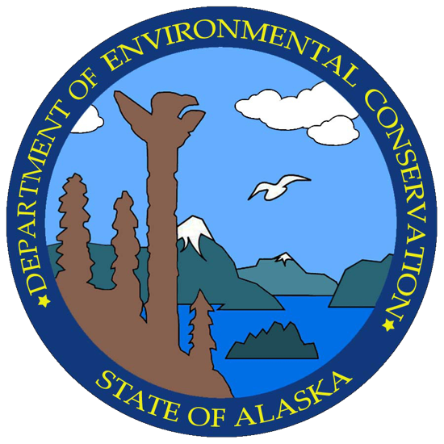
CHAPTER 3
USEPA Water Quality Regulation Overview
Notes:
“This is a review of the most important regulations for water treatment.”
Note: ABC has removed most of the USEPA regulation questions from the exam database that involve specific US numerical standards (such as MCLs) as the new exams are used in both the US and Canada, which has different regulations than the US. The general scope of what the regulations cover is, however, still in the exam question database.

Slide 2
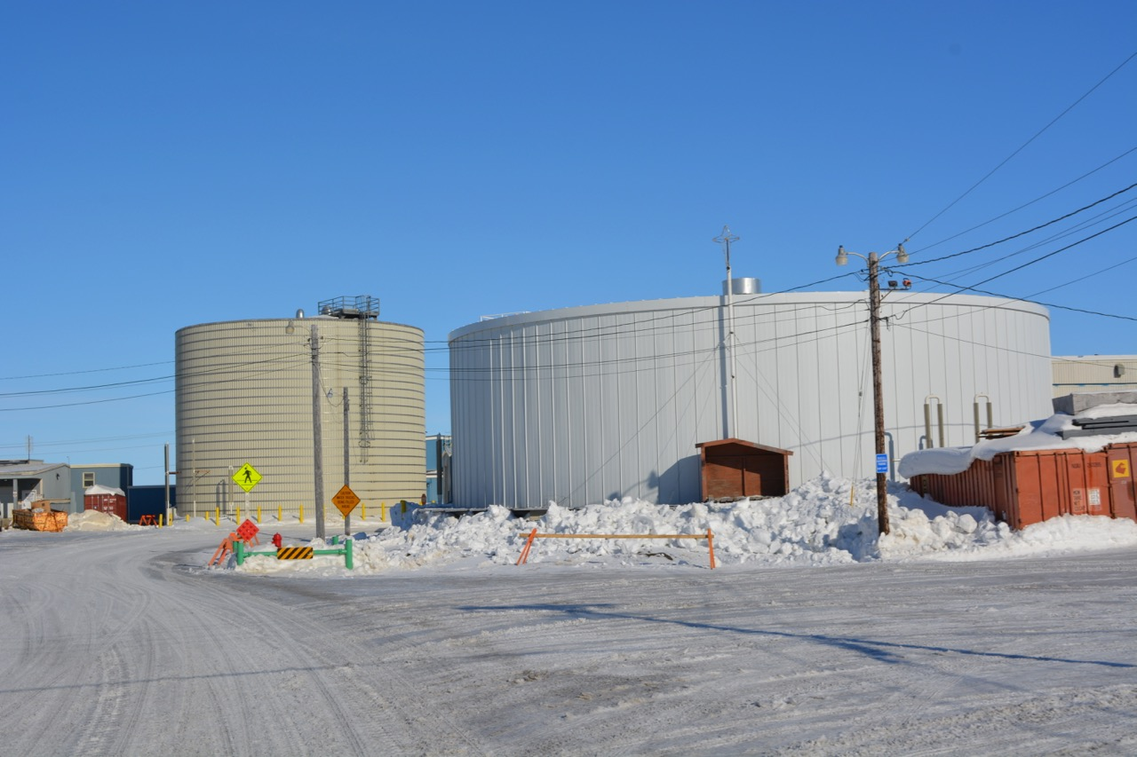
Types of Water Systems
Public Water System (PWS): “A supply of piped water for human consumption that has at least 15 service connections, or serves 25 or more persons 60 or more days each year.”
Community PWS: a system whose customers are full-time residents
Nontransient Noncommunity PWS: an entity having its own water supply, serving an average of at least 25 persons who do not live at that location, but who use the water for more than 6 months per year
Transient Noncommunity PWS: an entity having its own water supply, where an average of at least 25 persons per day visit and use the water occasionally or for only short periods of time
Notes:
In the definition of PWS, ask the class what a “service connection” is: a connection between a water main and a customer, usually through a flow meter
Background photo: Barrow Utilities & Electric Coop (BUECI) water storage tanks (1 MG on the left, 0.6 MG on the right)

Slide 3
Examples of Public Water Systems
Public Water Systems
Community Water Systems
Municipal Systems
Rural Water Districts
Mobile Home Parks
Nontransient Noncommunity Water Systems
Schools
Factories
Office Buildings
Transient Noncommunity Water Systems
Parks
Motels
Restaurants
Churches

Slide 4
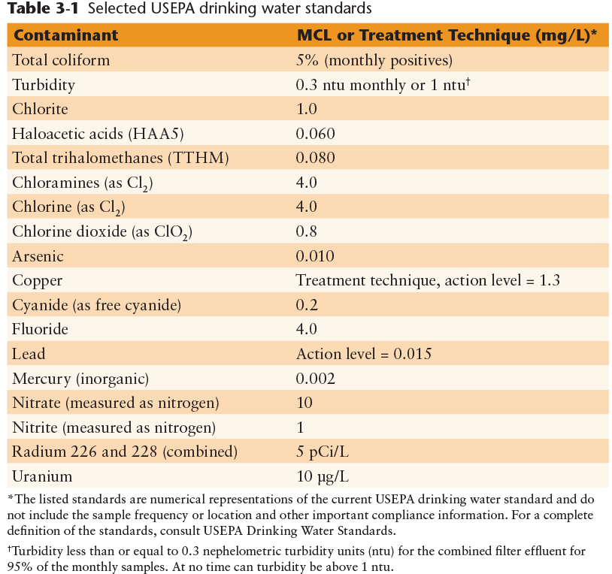
Maximum Contaminant Level Goal:
The MCLG is set at a level where there are no known, or anticipated, health effects.
For known or suspected carcinogenic substances, the MCLG is set at ”zero.”
Maximum Contaminant Level:
The MCL is set as close as feasible to the MCLG for substances regulated under the SDWA.
The MCL is an enforceable regulated level. If a water system exceeds an MCL, they must take steps to install treatment to achieve the MCL.
Where USEPA has found it impractical to set an MCL, a “Treatment Technique” can be established instead.
Copyright © 2016 the American Water Works Association
Notes:
Remind (or pose a question to) the attendees that mg/L is considered equivalent to PPM and µg/L is equivalent to PPB in water

Slide 5
Disinfection By-Product and Microbial Regulations
The use of potable water disinfectants since the late 1800s such as chlorine, ozone, and chlorine dioxide have greatly improved public health
Disinfectant chemicals have been found to react with organic and inorganic substances in treated water, occasionally producing by-products that have potential health effects
Thus: these two classes of regulations are often at apparent odds with each other and can be a challenge for water treatment operators to find the proper balance to address both of these issues

Slide 6
Disinfectants and Disinfection By-Products Rule (DBPR)
Stage 1 DBPR – HAA5 and TTHM Provisions
  Published by EPA in 1998
  MCL for Total Trihalomethanes (TTHM) set at 0.080 mg/L (80 µg/L)
  MCL for five regulated Haloacetic Acids (HAA5) set at 0.060 mg/L (60 µg/L)
  TTHM and HAA5 MCL compliance is calculated as a running annual average (RAA) of (typically) quarterly samples taken in the distribution system, usually at locations with the longest detention time
Notes:
Although EPA initially considered DBPs to be predominantly a surface water quality issue, the organic matter that is the precursor to the formation of DBPs has been found in ground water, too. In Alaska, high total organic carbon (TOC) concentrations are often found in wells drilled through continuous permafrost or in areas with discontinuous permafrost.

Slide 7
Disinfectants and Disinfection By-Products Rule
Stage 2 DBPR – HAA5 and TTHM Provisions
  Published by EPA in 2006
  TTHM and HAA5 MCL compliance is calculated as a locational running annual average (LRAA) of (typically) quarterly samples taken in the distribution system, at sample locations shown to have the highest TTHM and HAA5 data
  The sample sites for TTHM and HAA5 LRAA samples may be different and are in addition to the regular Stage 1 DBPR samples

Slide 8
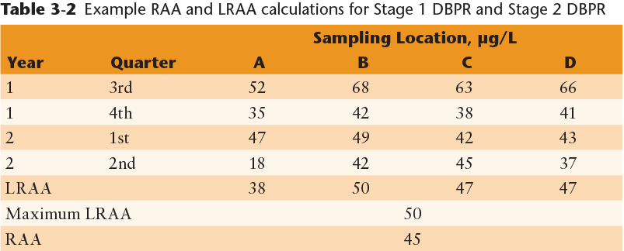
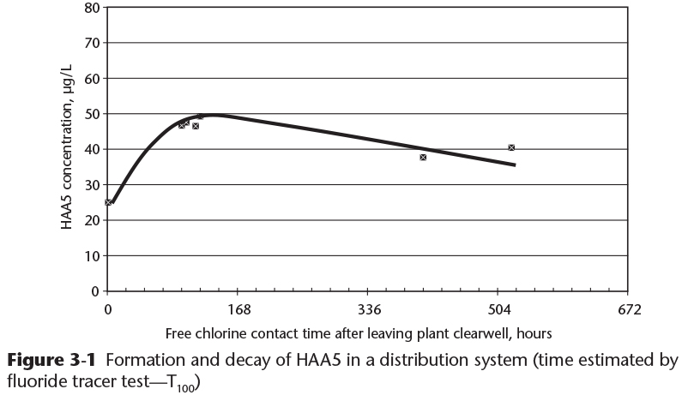
RAA and LRAA Calculation Example:
DBP concentrations change with time (water age),changes in temperature, chlorine residual, and pH:
Copyright © 2016 the American Water Works Association

Slide 9
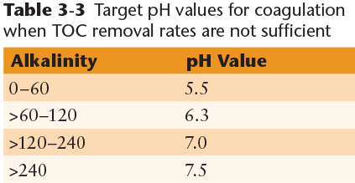
Other DBPR Provisions
Enhanced Coagulation Requirement of the Stage 1 and Stage 2 DBPRs
  Optimizes the use of water treatment coagulants to reduce the concentration of total organic carbon (TOC) that can form DBPs when reacted with disinfectant chemicals (see pages 91-92)
Bromate
  Formed from the reaction between ozone and bromide in water, MCL set at 0.010 mg/L (10 µg/L)
Chlorite
  One of the components used to make chlorine dioxide, residual chlorite MCL set at 1.0 mg/L
Copyright © 2016 the American Water Works Association

Slide 10
Residual Disinfectants Provisions of the DBPR
MRDL = Maximum Residual Disinfectant Level
  MRDL for total chlorine set at 4.0 mg/L
  MRDL for chloramines set at 4.0 mg/L
  MRDL for chlorine dioxide set at 0.8 mg/L
Hach Company Pocket Colorimeter II Free & Total Chlorine Residual Analyzer

Slide 11
Video Clip: Disinfection By-Products
www.awwa.org/wsovideoclips

Slide 12
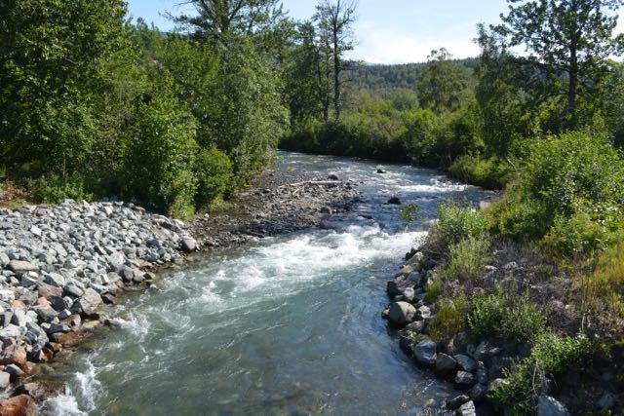
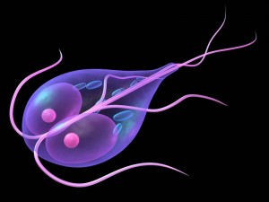
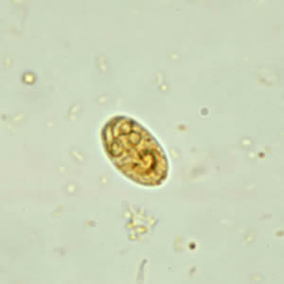
Surface Water Treatment Rule (SWTR)
Original SWTR was promulgated by EPA in 1989
  Target microorganisms were Giardia lamblia and enteric viruses
  Filtration and disinfection of surface water was required to accomplish this
  Treatment techniques for different types of filtration were established to meet appropriate removal requirements”
    3-Log (99.9%) removal of Giardia lamblia
    4-Log (99.99%) removal of enteric viruses
Giardia lamblia active or “trophozoite” stage
Giardia lamblia cyst (resting phase)
~ 5 x 15 microns
Notes:
Giardia lamblia was found to be the microorganism responsible for hundreds of waterborne disease outbreaks throughout the US in the 1970s and 1980s. The cyst form is resistant to chlorine and becomes active inside the small intestines of humans in a stage known as a trophozoite.

Slide 13
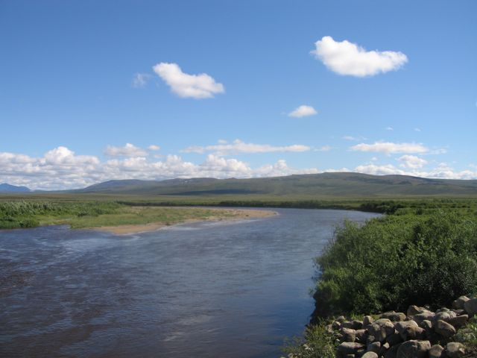
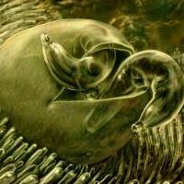
Enhanced Surface Water Treatment Rule (ESWTR)
Interim ESWTR promulgated by EPA in 1998
  Target microorganism was Cryptosporidium parvum
  Enhanced filtration treatment techniques of surface water were required to accomplish 2-Log (99%) removal in filtration
    Combined filter effluent turbidity ≤0.3 NTU
    Individual filter effluent monitoring for >2 filters operating in parallel
    C x T profiling and benchmarking
  See pages 93-94
Cryptosporidium parvum “trophozoites” hatching from an oocyst on the walls of an intestine.
The oocyst is ~ 4-6 microns in diameter.
Notes:
Cryptosporidium parvum was found to be the microorganism responsible for over 400,000 cases of cryptosporidiosis in Milwaukee, WI in 1993. That was the largest documented waterborne disease outbreak that has ever occurred in the US. The oocyst is virtually immune to the affects of chlorine. Like Giardia it becomes active inside the small intestines of humans in a stage known as a trophozoite. There is presently no known cure for cryptosporidiosis other than the body developing an immune response once infected. Of note, only one in four of the 1.6 million residents in Milwaukee contracted the disease.

Slide 14
Long-Term 1 ESWTR
Sanitary surveys are required for all surface water systems every three years
  Onsite review of the water sources, facilities, equipment, operation, and maintenance of a public water system
  Eight main sections to a sanitary survey (see list on page 94)
  Survey must be done by a trained surveyor, either an ADEC employee or an ADEC-approved third-party surveyor

Slide 15
Long-Term 2 ESWTR
Monitoring of all surface water treatment system sources is required:
  Monitoring for Cryptosporidium monthly for 24 consecutive months required for larger water systems
  Monitoring for a state-approved surrogate every two weeks for one year (26 samples) for smaller water systems
    ADEC selected E. coli as the surrogate for Alaskan surface water systems
  Systems with high levels of e. coli have to then monitor for Cryptosporidium
  Systems with high levels of Cryptosporidium in the source water will then have to increase the treatment to a level determined by a risk factor

Slide 16
Filter Backwash Recycling Rule (FBRR)
Treatment procedures for filter backwash water and other “side streams” such as supernatant from dewatering sludge are required
  Goal is to limit the amount of Cryptosporidium and Giardia recycled inside a water treatment facility
  Backwash and side stream water have to be returned to the beginning of the treatment process (e.g. prior to coagulation) or provided additional treatment
  For some facilities, separate treatment of backwash and side stream water is required prior to reuse

Slide 17
Video Clip: Filter Backwash
www.awwa.org/wsovideoclips

Slide 18
Ground Water Rule (GWR)
For groundwater systems that are at high risk for fecal contamination, particularly for groundwater systems that do not disinfect
Enteric viruses are the targeted organism – viruses are small enough to be able to move through aquifers that otherwise would filter them out such as with bacteria and protozoa (e.g. Cryptosporidium & Giardia)
If necessary, groundwater treatment (disinfection) will be required

Slide 19
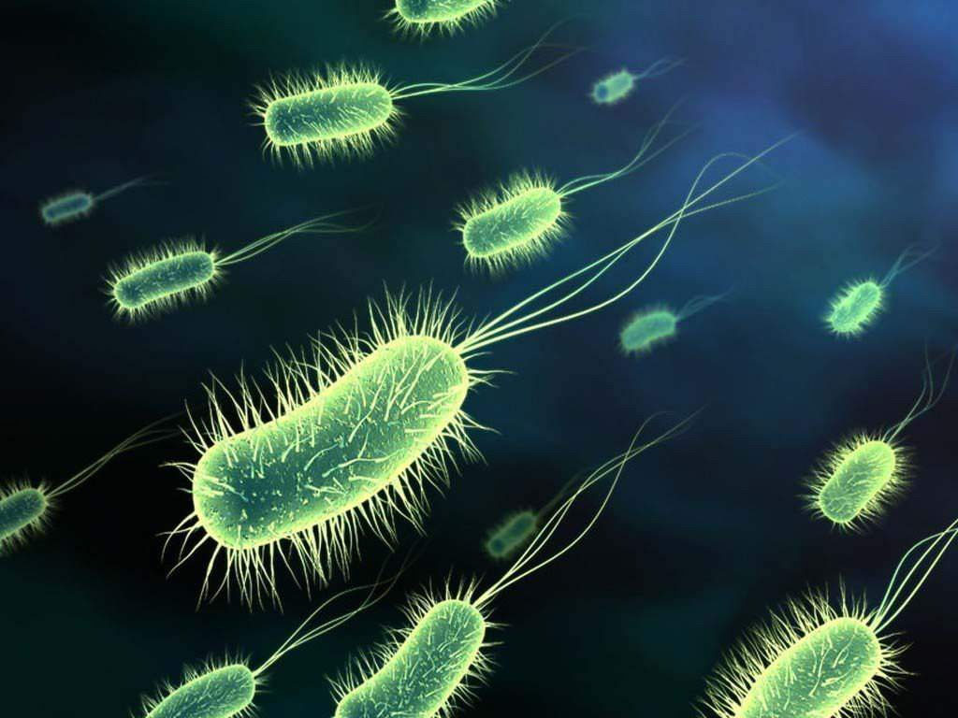
Total Coliform Rule (TCR) and Revised Total Coliform Rule (RTCR)
All public water systems are required to monitor their water distribution system for potential disease-causing microorganisms
Under the original TCR, total coliform bacteria (~100 species of intestinal bacteria) were monitored as indicators of possible fecal contamination. The MCL was set at zero.
Under the RTCR, an MCL of zero was established for Escherichia coli (E. coli), which is more indicative of human sewage pollution. The existing standard for total coliform bacteria was removed.
Notes:
Background picture: electron micrograph of a pure culture of E. coli bacteria (~10,000x magnification)

Slide 20
RTCR MCL Violations
E. coli MCL violation occurs with any of these sample result combinations:
A treatment technique violation will occur for any of the following:
ROUTINE SAMPLE | REPEAT SAMPLE
EC+ | TC+
EC+ | Any Missing Sample
EC+ | EC+
TC+ | EC+
TC+ | TC+ (but no E. coli analysis performed)
Failure to conduct a Level 1 or Level 2 assessment within 30 days of a trigger
Failure to correct all sanitary defects from a Level 1 or Level 2 assessment within 30 days of a trigger or within state-approved time frame
Failure of a seasonal system to complete state-approved start-up procedures prior to serving water to the public at the start of the season
[See Page 97 of the Text]
Notes:
A Level 1 assessment is an internal system audit performed by the utility, while a Level 2 assessment is an external audit usually performed by ADEC

Slide 21
Video Clip: Coliform Sampling 2
www.awwa.org/wsovideoclips

Slide 22
Lead & Copper Rule
December 1992, Revised in 2007
90th Percentile Action Levels
  0.015 mg/L (15 µg/L) for Lead (Pb)
  1.3 mg/L for Copper (Cu)
Monitoring requirements
  First draw samples
  Reduced monitoring for compliant systems
Public education requirements for exceeding Pb action level
Corrosion treatment for systems exceeding either action level
Notes:
The photo is a service line with lead pipe (the bulbous fitting is typical of lead pipe)

Slide 23
Video Clips:
Lead & Copper Rule
Water Quality and Household Plumbing
Water Quality and Faucets
www.awwa.org/wsovideoclips
Notes:
Note: the important one is the Lead and Copper Rule – the others can be skipped in the interest of time

Slide 24
Other PWS Regulations
Phase I (1989), II (1992), and V (1995) Contaminants
  Primary inorganic and some organic contaminants with MCLs
  Monitoring frequencies vary from annual to 9 years with reduced monitoring
Public Notification Rule
  Mandatory language and notification methods and times ranging from 24 hours to annual, depending on the health risk of the violation or incidence
  See list on page 99 of the text for examples of notification requirements

Slide 25
Other PWS Regulations
Unregulated Contaminant Monitoring Rule (UCMR)
  Established in 1996, this rule requires a statistically selected group of utilities to monitor for new and emerging contaminants that may be regulated in future revisions to the drinking water standards
Operator Certification
  1996 Amendments to the Safe Drinking Water Act required USEPA to establish national guidance for water system operator certification
  Most states administer their own water system operator certification program under state primacy rules
Notes:
As an example: Per- and Polyfluorinated Alkyl Substances (PFAS) compounds (e.g. PFOS and PFOA from aqueous film-forming foam used in fire suppression) were investigated in UCMR 3. EPA is now considering a new national MCL for these two substances, which have received lots of attention in the press over the past several years.

Slide 26
Other PWS Regulations
Arsenic MCL
  The USEPA MCL for arsenic was reduced from 50 µg/L to 10 µg/L. Arsenic is a common naturally-occurring ground water contaminant in Alaska, often in water that also has high concentrations of iron and manganese.
Radionuclides Rule
  Finalized MCLs for gross alpha and beta radiation, photon emitters, radium 226 and 228, and uranium
Analytical Methods
  Establishes approved testing methods for potable water contaminants

