Slide 1

CHAPTER 8
Coagulation and Flocculation

Slide 2

Removal of Nonsettleable Solids
Nonsettleable solids are particles that are so small they do not settle in a reasonable amount of time. These are referred to as turbidity and include:
  Biological organisms such as viruses, bacteria, protozoa, algae
  Color-causing organic particles
  Organic and inorganic solids
Turbidity particles may interfere with disinfection, shielding pathogenic microorganisms from disinfectants
The most common treatment method for turbidity removal is conventional treatment consisting of:
  Coagulation, flocculation, sedimentation, and filtration

Slide 3
Process Description
Coagulation and flocculation convert the small, nonsettleable solids into larger, more settleable particles by physical-chemical changes
Nonsettleable solids resist settling due to the small particle size and the natural repellant forces between the particles (see Table 8-1)
Particles in water (Figure 8-1) include:
  Suspended solids, which include settleable solids
  Colloidal solids – nonsettleable suspended solids that cause turbidity
  Dissolved solids – substances dissolved in water, the size of a molecule and invisible to the naked eye
Notes:
Suspended solids are separated with a filter with a porosity of 1.2 to 1.5 microns in the laboratory. Colloidal solids are very fine suspended solids (they are not truly dissolved) but are so small they will pass through a suspended solids filter and will scatter and absorb light (which is the definition of turbidity).

Slide 4
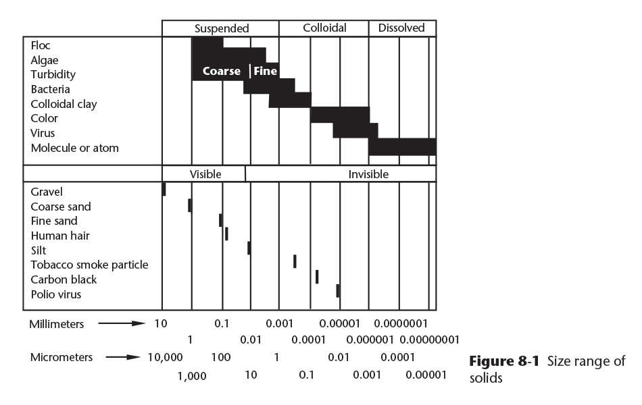
Suspended, Colloidal, and Dissolved Solids
Copyright © 2016 the American Water Works Association

Slide 5
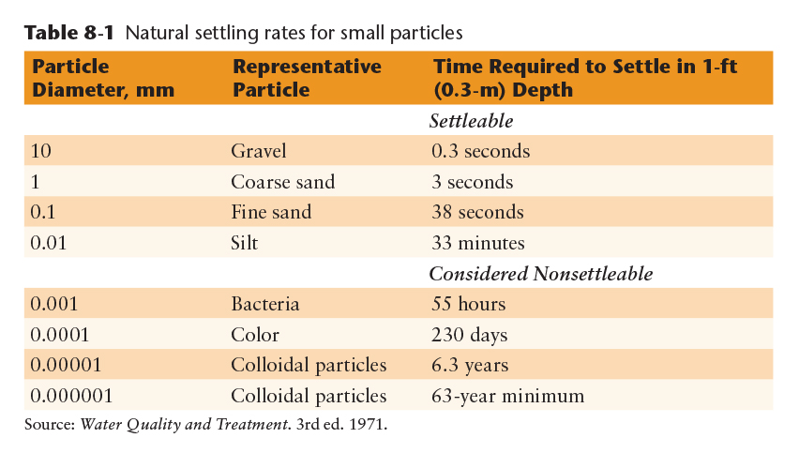
Particle Size
Particles smaller than 0.001 millimeter (less than 1 micron or 1µ) are considered to be nonsettleable
These are the materials that are the targets of coagulation and flocculation
Copyright © 2016 the American Water Works Association

Slide 6
Natural Forces
Colloidal particles in water carry a negative surface electrical charge that acts like one pole of a magnet
  Like poles (like charges) repel each other, while opposite poles attract each other. The intense negative surface charge on colloids creates a repulsive force called the zeta potential.
  The opposite (attractive) force on particles is called the van der Waals force and causes particles to gather together in water, air, or the vacuum of space
  The zeta potential is stronger than the van der Waals force for turbidity particles in water, thus turbidity won’t form clumps and settle out naturally

Slide 7
Effect of Coagulation and Flocculation
Coagulation-flocculation processes neutralize the zeta potential repelling nonsettleable solids and thus allows the van der Waals force to form larger particles
This is a two-step process:
  During coagulation small microfloc particles are formed. This is a chemical process and is very rapid.
  During flocculation, larger macrofloc particles are formed. This often involves the addition of a second chemical, usually a polymer, to aid the formation of larger particles. Flocculation is a physical process as it uses gentle mixing for a period of time to form the macrofloc.
  See Figure 8-2.

Slide 8
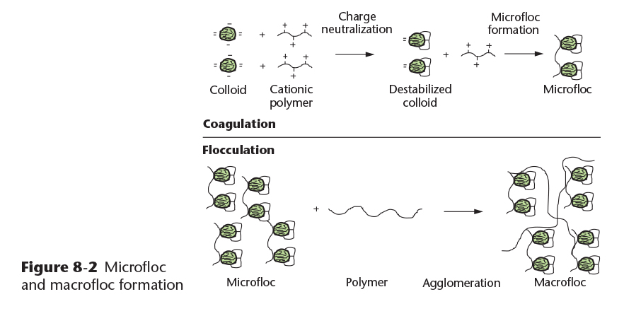
Effect of Coagulation and Flocculation
Copyright © 2016 the American Water Works Association

Slide 9
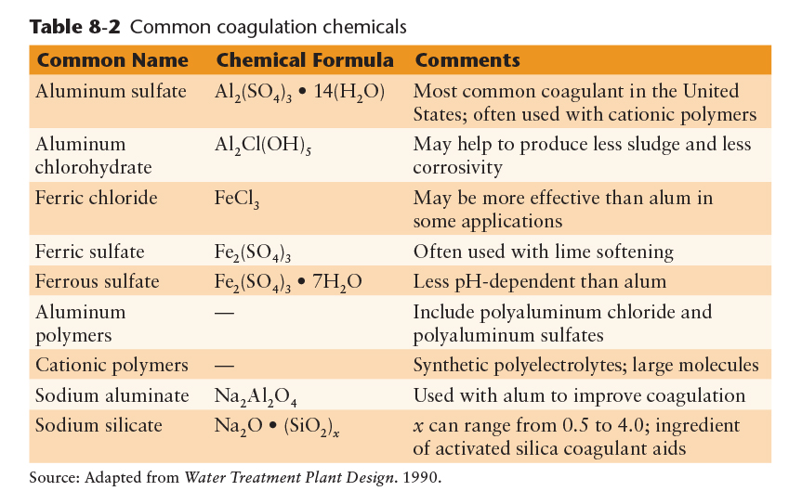
Coagulant Chemicals and Feed Equipment
Common coagulant chemicals are shown in Table 8-2
All coagulants have a very strong positive electrical charge that allows them to attract the negatively charged colloidal particles
Copyright © 2016 the American Water Works Association
Notes:
Tables 8-3 and 8-4 on page 196 can be mentioned, but the information provided is beyond the Grade 1 Operator Certification level of knowledge, as is much of the detail in pages 194 to 198. A common exam question regards alum as being the most common inorganic coagulant used throughout the world (or in the US as noted in Table 8-2).

Slide 10
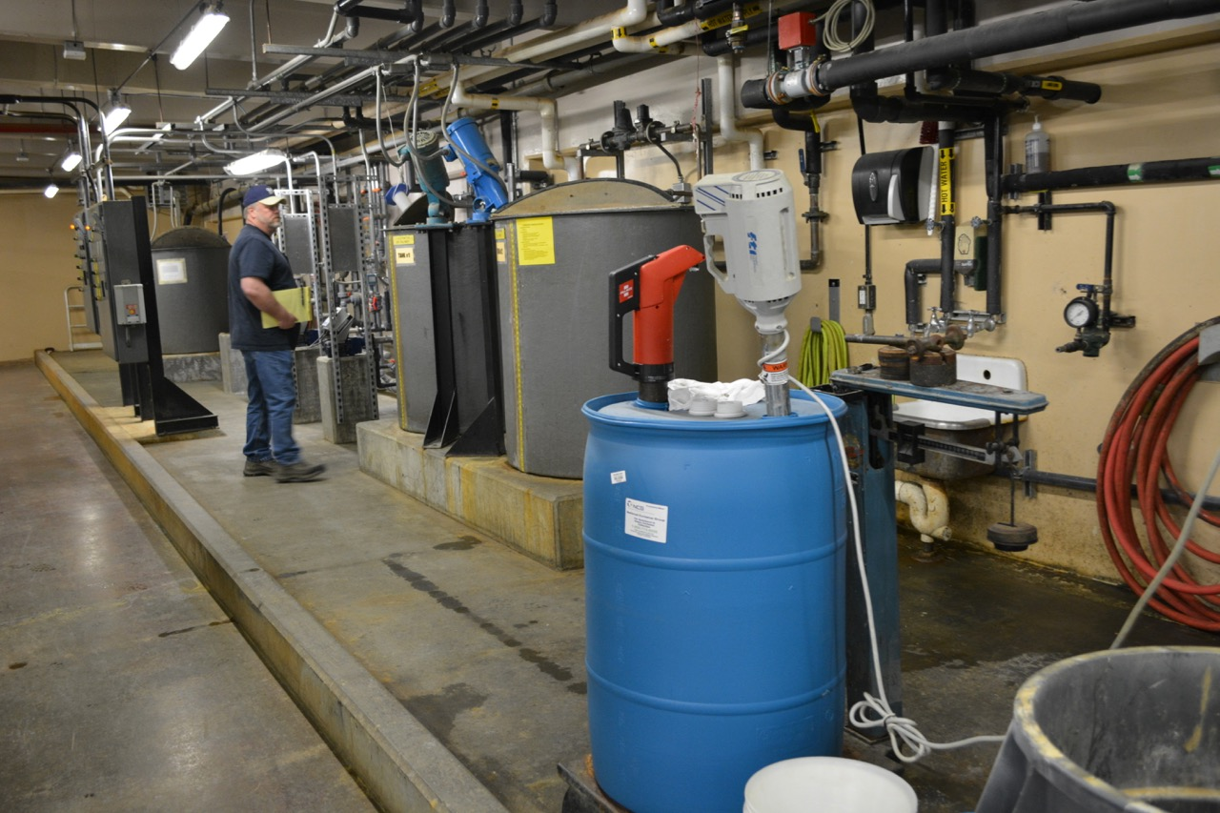
Coagulant Aids
Coagulant aids are added during coagulation to:
  Improve the coagulation process
  Build stronger more settleable floc
  Overcome low water temperature effects
  Reduce the required coagulant dosage
  Reduce the amount of sludge produced
Notes:
Background photo: polymer solution mixing and feed station at the Golden Heart Utilities water treatment plant in Fairbanks

Slide 11
Coagulant Aids
Types of coagulant aids:
  Activated silica – see page 197 for application notes
  Weighting agents – bentonite clay is often used to increase the amount of colloidal solids to make coagulation more effective
  Polyelectrolytes or polymers – large, synthetic molecules manufactured with the following charges:
    Cationic – positively charged, often added directly with the coagulant to enhance the chemical coagulation process
    Anionic – negatively charged, usually added after coagulation and prior to flocculation to help build the size and density of the macrofloc
    Nonionic – balanced charges, used as an alternative to anionic polymers in applications where particles with both negative and positive charges are present

Slide 12
Chemicals Used to Raise Alkalinity
The coagulation process consumes some of the alkalinity in the raw water. If insufficient alkalinity is present in the raw water, some will need to be added to complete the coagulation reaction. Alkaline chemicals include:
  Lime – calcium hydroxide (hydrated lime) or calcium oxide (quicklime)
  Soda ash – sodium carbonate
  Caustic soda – sodium hydroxide
  Sodium bicarbonate – also known as baking soda
All chemicals added to potable water require approval under the American National Standards Institute/National Sanitation Foundation or ANSI/NSF Standard 60

Slide 13
Video Clip: Coagulation and Flocculation
www.awwa.org/wsovideoclips

Slide 14
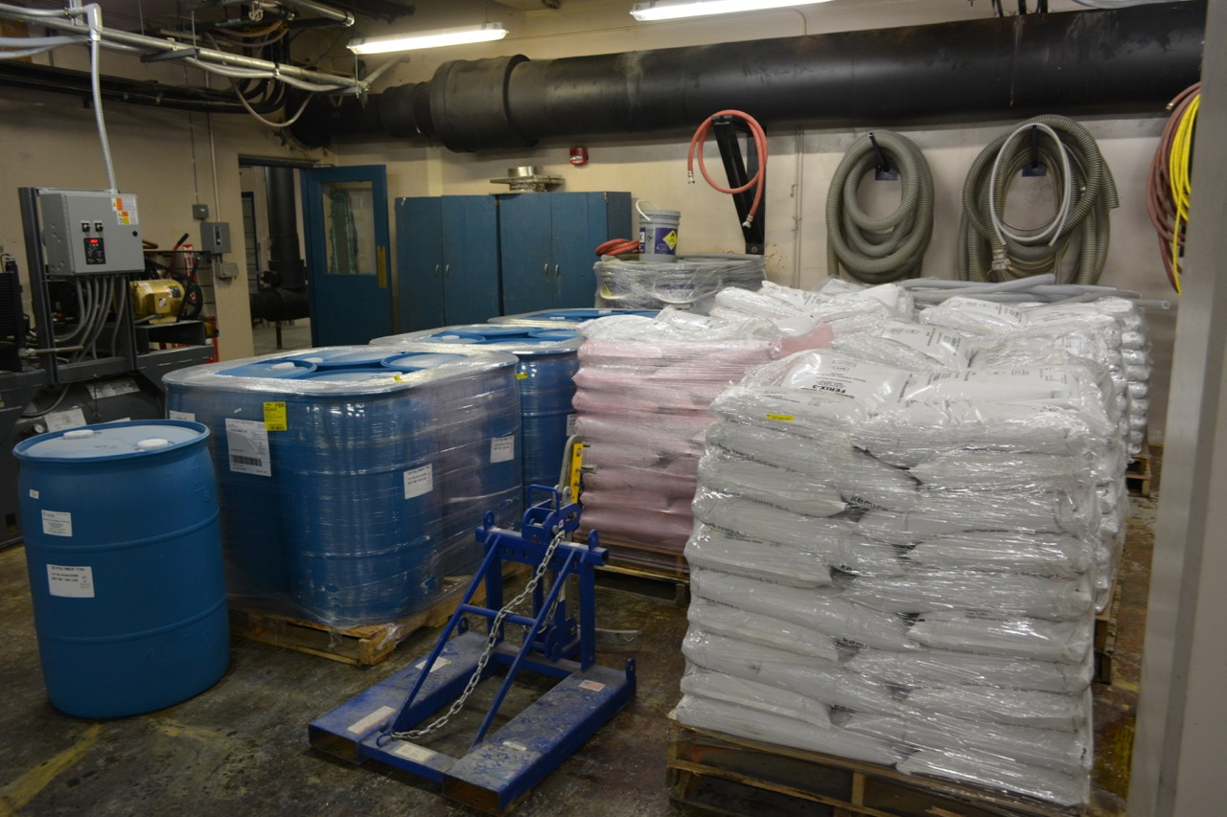
Chemical Purchasing, Receiving, and Quality Control
Purchasing specifications for water treatment chemicals are needed for proper quality control, to verify proper strength and grade, and to ensure proper delivery procedures are maintained
  See list on page 199
Chemical storage and handling
  The type of chemical (solid granules, powder, liquid) and size of packaging should be specified
  Chemical storage should be stored in a dry, clean area, on pallets to allow air circulation, and with proper access for handling equipment
  The storage area should be managed so that only compatible chemicals are stored together
Notes:
Background photo – GHU water treatment plant: well managed chemical storage area

Slide 15
Video Clip: Water Treatment Chemicals
www.awwa.org/wsovideoclips

Slide 16
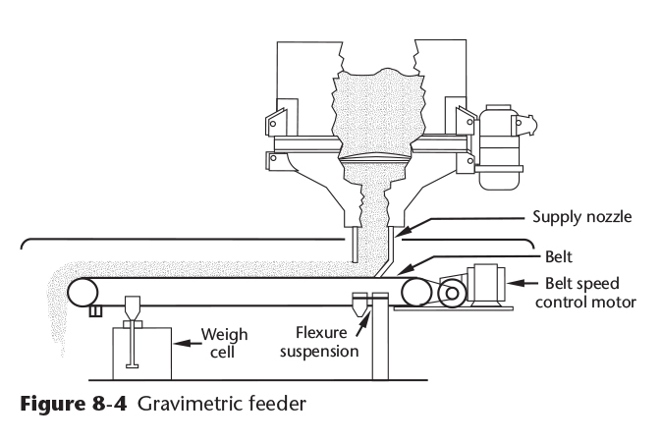
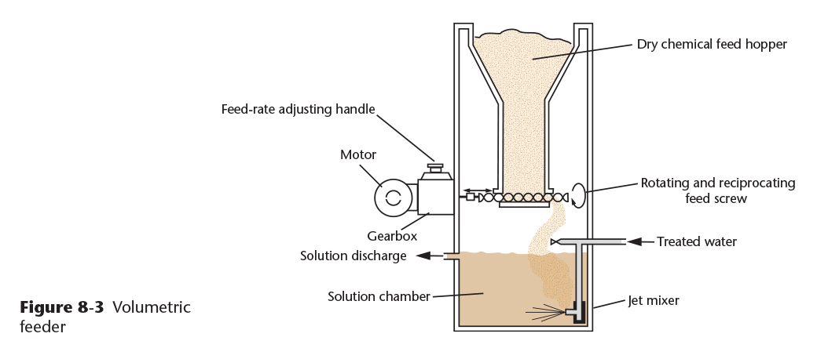
Chemical Feed Equipment – Dry Feeders
Volumetric Feeders – a specific volume is dosed over a period of time
Gravimetric Feeders – a specific weight is dosed over a period of time
Copyright © 2016 the American Water Works Association

Slide 17
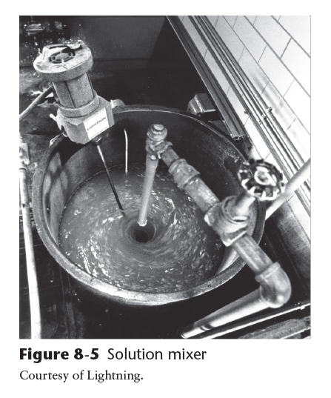
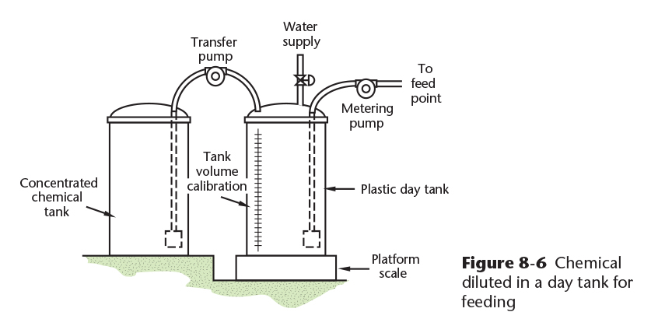
Chemical Feed Equipment – Solution Feeders
Chemical solution tank equipped with a solution mixer
Liquid chemical system for diluting a concentrated chemical into a day tank
Copyright © 2016 the American Water Works Association
Notes:
Safety note: Always add the concentrated chemical to the water in the solution tank (add acid to water, or base to water, etc.)

Slide 18
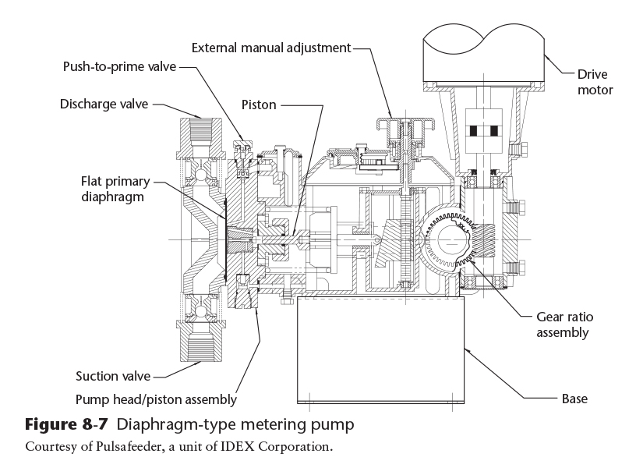
Chemical Feed Equipment – Solution Feeders
Diaphragm-type chemical feed pump
Chemical solution feed pumps
Positive-displacement metering pumps deliver a consistent, precise volume of chemical over times and include:
  Diaphragm pumps (Figure 8-7)
  Peristaltic pumps
  Piston pumps
  Progressive cavity pumps
Copyright © 2016 the American Water Works Association

Slide 19
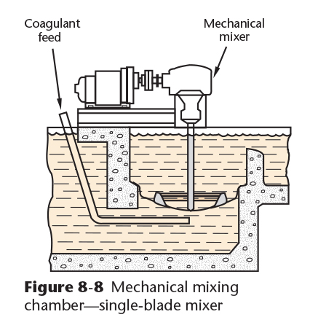
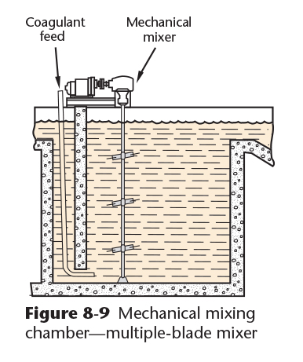
Rapid-Mix Facilities
Rapid, complete mixing of coagulant chemicals into the water is essential for a proper coagulation reaction
The coagulant must be completely dispersed rapidly to ensure proper particle collisions so that a good microfloc forms
Perforated pipe grids may also be used to help evenly disperse the coagulant
Mechanical Mixers:
Copyright © 2016 the American Water Works Association

Slide 20
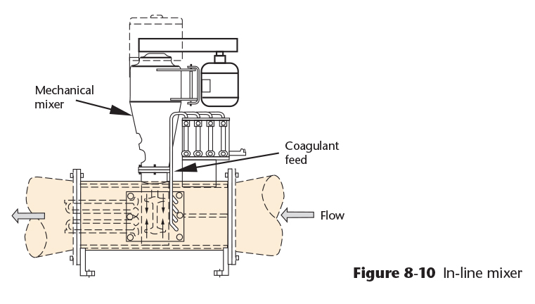
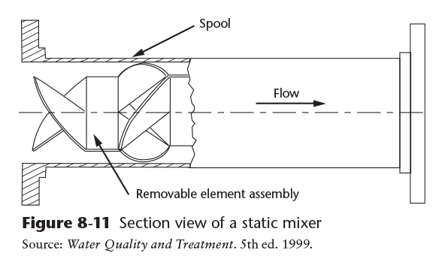
Rapid-Mix Facilities
Mechanical In-Line Mixers: Static In-Line Mixers:
Copyright © 2016 the American Water Works Association

Slide 21
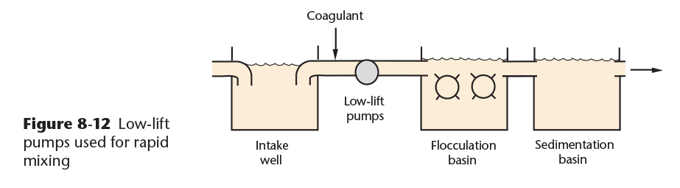
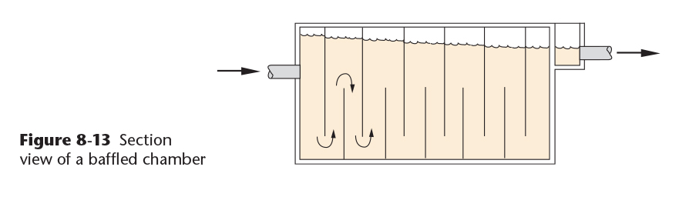
Rapid-Mix Facilities
Pumps and Conduits:
Baffled Chambers:
Copyright © 2016 the American Water Works Association

Slide 22
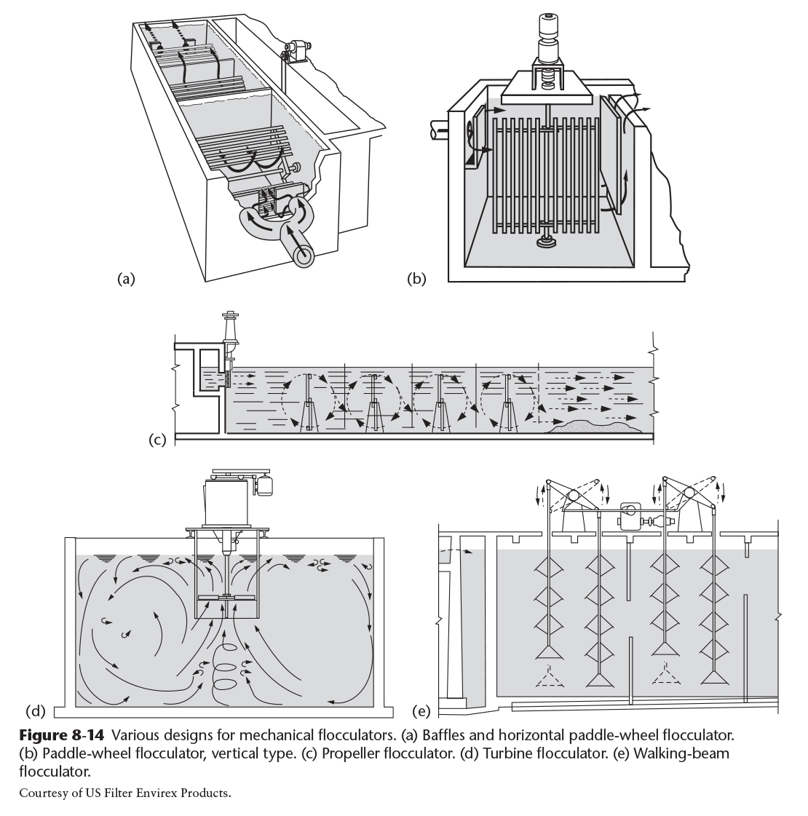
Flocculation Facilities
Flocculation follows coagulation
Slow, gentle mixing to build the particle size of the floc
Baffled chambers are used to reduce short-circuiting
Mixing energy is reduced (tapered) in multiple stages to prevent shearing of the fragile floc as it grows
Figure 8-14: flocculator design examples
Copyright © 2016 the American Water Works Association

Slide 23
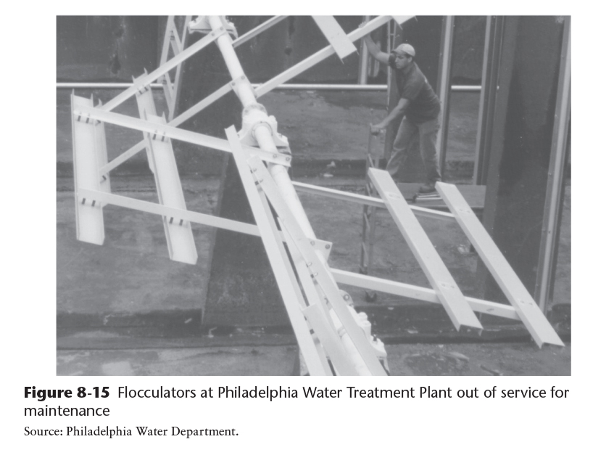
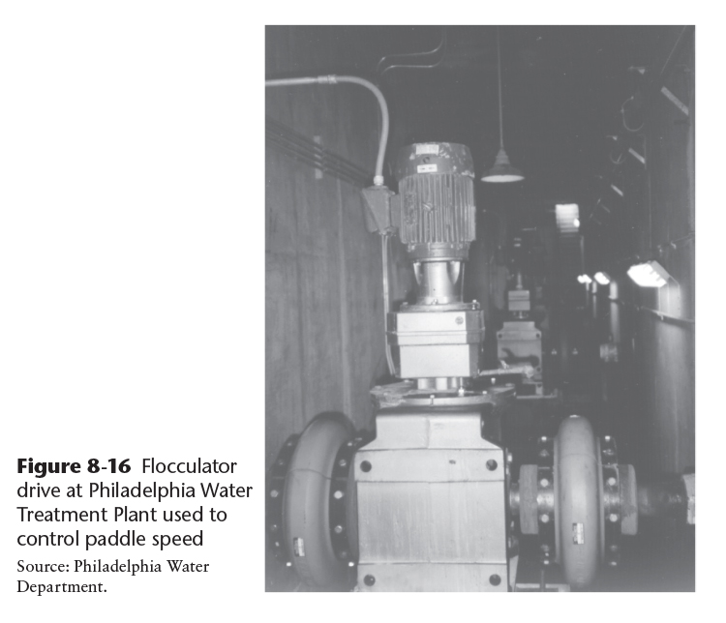
Flocculation Facilities
Copyright © 2016 the American Water Works Association

